Slide 1

Product Management
Certification Program
Industry Project - I
Shailly Shah - shaillyshah711@gmail.com
Manav Bhardwaj - manavbhardwaj16@gmail.com
Narayanlal Romina - naruromina@gmail.com
Notes:
© Copyright UpGrad Education Pvt. Ltd. All rights reserved

Slide 2
Submission Guidelines
After completing all the parts of the project, you will have to submit your responses in the following manner.
Submit the following parts of the project in this “Presentation’’ file
Part 1 - Understanding the market
Part 2 - User research
Part 5 - MVP Creation
Part 6 - Sketching
Part 7 - Wireframing & Prototyping
Submit the following part of the project in the template document provided on the platform.
Part 3 - Business Model Canvas
Part 4 - Product Artifacts
User Persona
User Journey Map
Note: Finally you have to add this Presentation & other submission documents in a ZIP folder and upload it in the submission section on the platform. More details in slides to follow
Notes:
© Copyright UpGrad Education Pvt. Ltd. All rights reserved

Slide 3
Part 1: Understanding the Market
Notes:
© Copyright UpGrad Education Pvt. Ltd. All rights reserved

Slide 4
Target Market Identification
DEMAND SIDE APPROACH
Considering the market for food delivery business is majorly operated in urban India where the population is around 30% i.e. 45Cr out of the Total Population of India 140+Cr. Taking it as 150cr for a round figure.
After getting the Target Available Market, we also need to gauge the Internet Penetration in the urban regions of India. Which is around let’s say 75% i.e. 33,75,00,000 Service Available Market.
Out of the above research, let’s consider people who order food online will be around 25Cr. They will be the actual users or people who often prefer using these kinds of services.
This means the Service Obtainable Market Of the Food Delivery Business is 25 Crores. Also, this means if we sideline the competitors then we have a great opportunity to cater with our offerings.
Notes:
© Copyright UpGrad Education Pvt. Ltd. All rights reserved

Slide 5
Porter's Five Forces Analysis
Threat Of New Entrant:
- It is difficult for a new player to enter this market, A lot of operational work is been involved.
- Requires a huge workforce and investment for marketing and operational expenses.
- High Competition in the market. [Scale (4/5) high risk is involved]
Buyer Bargaining Power:
- Buyers have too many options, which means buyer bargaining power is high.
- Buyers are price sensitive and mostly interested in discounts
- Prefer to compare before ordering the food. [Scale (5/5) high risk is involved]
Supplier Bargaining Powers:
- In this case, Restaurant partners are the suppliers for our platform.
- The ratio of suppliers is lesser than the number of buyers.
- Suppliers can be a direct competitor by setting up their own platforms (web/app)
[Scale (3/5) high risk is involved]
Notes:
© Copyright UpGrad Education Pvt. Ltd. All rights reserved

Slide 6
Porter's Five Forces Analysis
Threat Of Substitute:
- This service can be substituted by the Home cook foods.
- Dine-ins are one of the ways that could substitute food delivery services. [Scale (4/5) high risk is involved]
Competitor Rivalry:
- Already major brands are dominating the market with their huge resources.
- Cutthroat competition among the existing players to acquire customers in terms of discounts, offers, etc.
[Scale (4/5) high risk is involved]
Notes:
© Copyright UpGrad Education Pvt. Ltd. All rights reserved

Slide 7
Porter's Five Forces Template
Threat of Entry
Lot of operational work
Requires a huge workforce and investment
High Competition
Bargaining Power of Buyers
Buyers have too many options
Price Sensitive Buyers
Compare before ordering
Competitive Rivalry
Major brands are dominating
Cutthroat competition in customer acquisitions
Bargaining Power of Suppliers
Restaurant partners are the suppliers
Ratio of suppliers is lesser
Suppliers can be a direct competitors
Threat of Substitutes
Home cook food
Dine-ins substitutes
Notes:
© Copyright UpGrad Education Pvt. Ltd. All rights reserved

Slide 8

Competitor Analysis
Competitors Background
SWOT Analysis
Competitors Analysis & Services
Competitor App Downloads
Competitors Comparisons
Pain Points of Competitors Customer
User Feedback of Competitors
Future Initiatives of Competitors
Notes:
© Copyright UpGrad Education Pvt. Ltd. All rights reserved

Slide 9
Competitors Background
Company Overview | Swiggy (DC1) | Zomato (DC2)
Founded | 2014 | 2008
Founder | Nandan Reddy, Rahul Jamini | Deepinder Goyal, Pankaj Chaddah
Head Quarters | Bangalore | Gurugram
No.of Employees | 5,000+ | 5,000+
Parent Organisations | Bundl Technologies Private Limited | Eternals
Goals/Mission | To surprise taste buds but also to deliver happiness | Our Mission is to ensure nobody has a bad meal
Hub tags | Unicorn | Listed
Geographical Reach | 500 cities | 500 cities
Tag line | 'Swiggy Karo, Phir Jo Chahe Karo! | Every meal matters
Notes:
© Copyright UpGrad Education Pvt. Ltd. All rights reserved

Slide 10
Competitors Background
Total Funding | $3.57B | $2.6B
Last Funding type | Series J | IPO
Funding Status | Last Funding Type Venture | Post IPO
No of Investors | 42 investors. | 29 investors
Revenue (YOY) | Rs 5,705 crore FY22 Rs 2,547 crore in FY21 Rs 3,727.7 Cr in FY20 | Rs 4,108.50 crore in FY22 Rs 1,845.82 crore in FY21 Rs 2,485.76 crore in FY2020
Net Worth/ Valuation | $5.5 billion | $5.39 Billion
Acquisitions/ Investment | 5 acquisitions and 5 investments. | 11 acquisitions and 13 investments
Revenue Streams | Restaurant listings, Commission, Promotions, Affiliate income, Swiggy loyalty program | Dine outs, Ticket Sales, Consultation Services, Zomato loyalty program, Delivery Charges, Restaurant listings
Notes:
© Copyright UpGrad Education Pvt. Ltd. All rights reserved

Slide 11
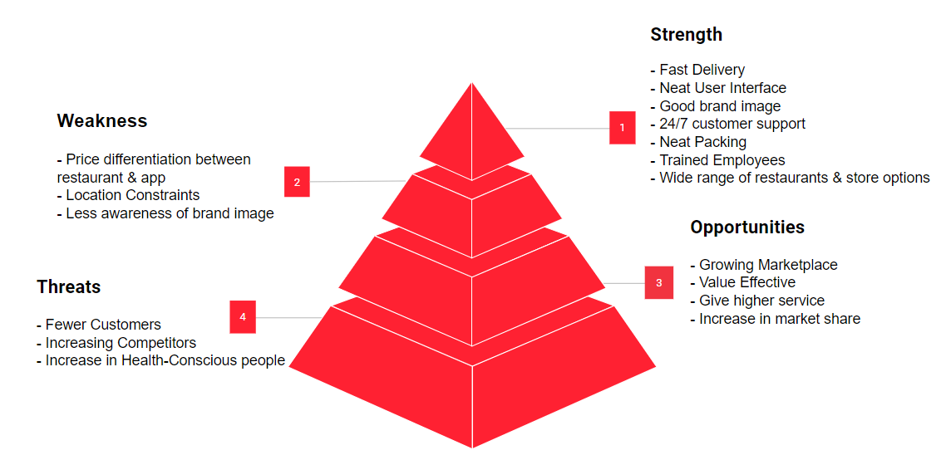
SWOT Analysis - SWIGGY
Notes:
© Copyright UpGrad Education Pvt. Ltd. All rights reserved

Slide 12
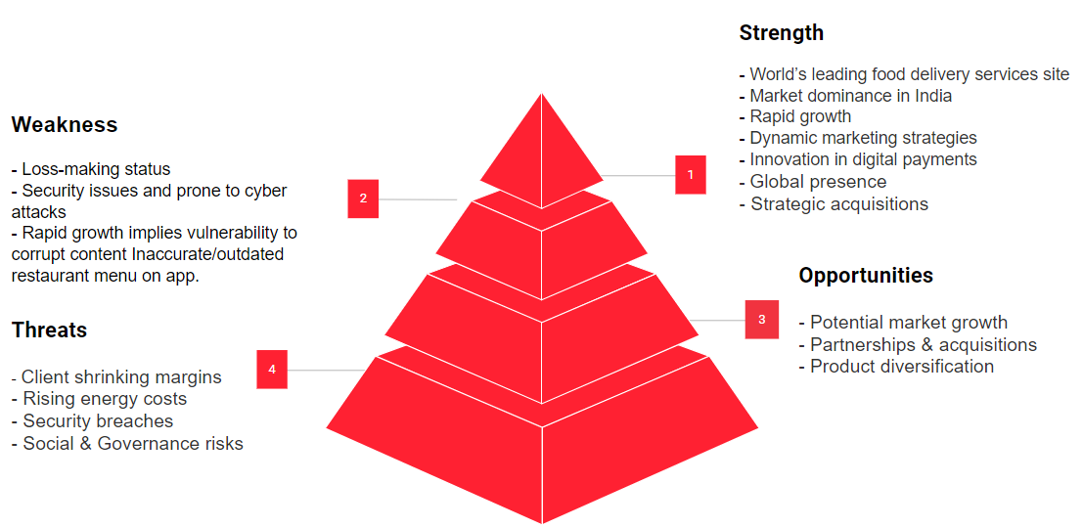
SWOT Analysis - ZOMATO
Notes:
© Copyright UpGrad Education Pvt. Ltd. All rights reserved

Slide 13
Competitor Analysis & Services
 | Swiggy (DC1) | Zomato (DC2)
Value-added Services | Unlimited free deliveries on food orders from all restaurants up to 10 Kms, | Privileges and discounts on the best restaurants across dining out and delivery
Shift In Business Model | Started as Bundl to facilitate courier and shipping service within India. Later as food delivery business started rising company found great opportunity in it and shifted its business model towards food delivery aggregators. | Earlier the business was started as helping people to find menus of restaurants named it as foodiebay, Later changed it to Zomato and started as a food delivery platform.
YOY Revenue Projection | 40% (FY22) | 109% (FY22)
No. Of Daily Orders | 1.4 - 1.6 Million | 2 Million
Average Order Value | Appx 400 Rs | 455 Rs
Notes:
© Copyright UpGrad Education Pvt. Ltd. All rights reserved

Slide 14
Competitor App Downloads
OS Platforms | Play Store (Swiggy) | IOS (Swiggy) | Play Store (Zomato) | IOS (Zomato)
App Downloads | 100 M+ | 13 M+ | 100 M+ | 20 M+
Star Ratings | 4.5 / 5 | 4.4 / 5 | 4.4 / 5 | 4.6/ 5
No Of Reviews on OS Platforms | 5 Million | 750k | 7 Million | 2.7 million
Notes:
© Copyright UpGrad Education Pvt. Ltd. All rights reserved

Slide 15
Competitor Comparisons
 | Swiggy | Zomato
Existence | Swiggy came in 2014 | Talking about Zomato it was founded in 2008 at that time app was used to tell about restaurants, pricing and menu. It came into operations in 2015 after Swiggy’s success
Payment Method | Swiggy will tell you how to pay it. But in Swiggy there is an option of ‘COD’ i.e cash on delivery | In Zomato payment it is easier and simpler because this app saves previous payment methods. COD applicable after certain amount/order
Location Tracking | Swiggy is faster | Zomato every time a person has to turn on the locations but it does wonders if it is switched on
Delivery Time | Swiggy deliver the food before the time is shown on the app | Zomato’s delivery is not as faster as swiggy
Marketing Strategy | Swiggy recommends you new places | Zomato keep on reminding you about their existence in the market. People loves zomato marketing more
Notes:
© Copyright UpGrad Education Pvt. Ltd. All rights reserved

Slide 16
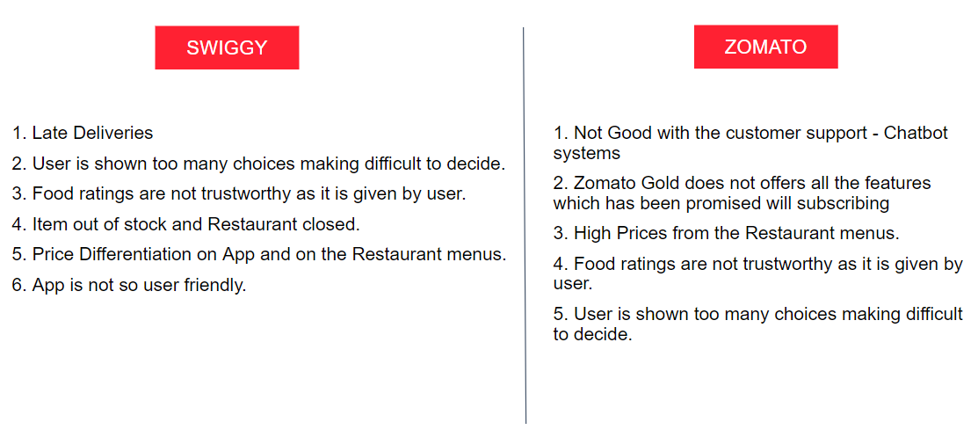
Pain Points Of Competitors Customer
Notes:
© Copyright UpGrad Education Pvt. Ltd. All rights reserved

Slide 17
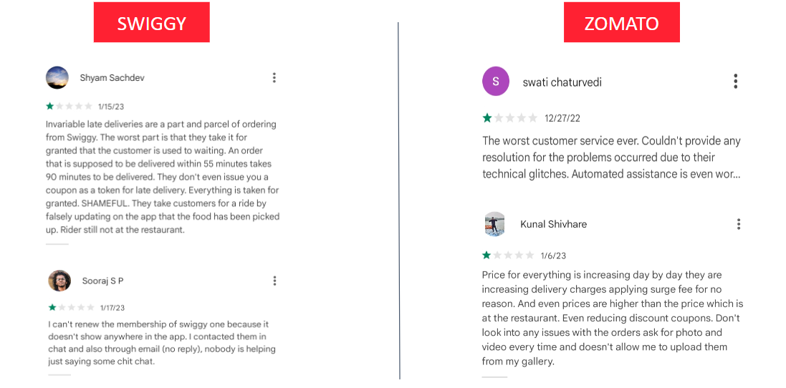
User Feedback Of Competitors
Notes:
© Copyright UpGrad Education Pvt. Ltd. All rights reserved

Slide 18
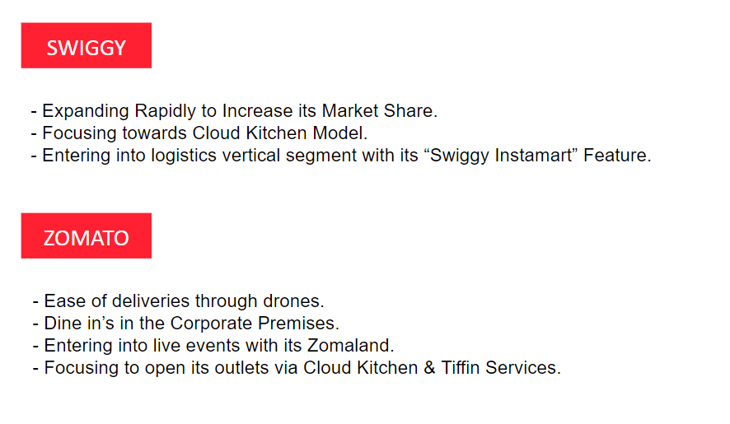

Future Initiatives Of Competitors
Notes:
© Copyright UpGrad Education Pvt. Ltd. All rights reserved

Slide 19
Part 2: User Research
Notes:
© Copyright UpGrad Education Pvt. Ltd. All rights reserved

Slide 20
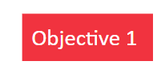
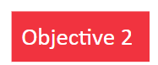
Objectives & Hypotheses
Understanding major users/target market for our services
Hypothesis:
1. People prefer to order food online - [ Hypothesis proved to be True ]
2. People usually belonging to a 15 - 35 age group - [ Hypothesis proved to be True ]
3. Majorly lives in the metro parts of India - [ Most of them, so Hypothesis proved to be True ]
Understanding users needs from the food delivery service model
Hypothesis:
4. Needs Correct Tracking System - [ Hypothesis proved to be True ]
5. Good Quality Food with no time limitations while delivery - [ Hypothesis proved to be False, good quality food required than
quick ]
6. People are willing to pay not more than 10rs for deliveries - [ Hypothesis proved to be False, 30% agreed to pay more than 10 ]
7. Food ordering via Apps is done at least once a week [ Hypothesis proved to be False, 46.7% said that they order more than once a week ]
8. Payment preferred to pay via UPI [ Hypothesis proved to be True ]

Slide 21
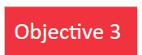
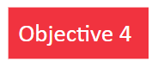
Objectives & Hypotheses
Understanding customers preferences related to quality of food delivered via restaurants
Hypothesis:
9. People are willing to trust the quality of food made by the restaurant [ Hypothesis proved to be False, 53.3% said that they find problems in food quality ]
10. Food Packaging Issues [Hypothesis proved to be True ]
Understanding how loyal are the users with the current food delivery partners
Hypothesis:
11. Most of them are loyal with their providers [ Hypothesis proved to be False, Because of discount people prefer to switch too]
12. Never had any issues with their providers while food ordering [ Hypothesis proved to be False, 56.7% users says that they get confused while ordering. Because they finds lot of options while ordering which confuses them and also Price shared are non transparent. ]
13. People are satisfied with the current food delivery service providers [ Hypothesis proved to be True ]

Slide 22
Surveys
Questionnaire Link :
https://docs.google.com/forms/d/e/1FAIpQLScOR1Kg2DexsxiVwTPIpcK38snB5WZ67dv7YtfEDIryYXzpuA/viewform
Graphical Response Results:
https://docs.google.com/forms/d/1m_4WGx2rmyb_ORKTdU4XhW0oa3moMTf8nCFPDphp_rQ/viewanalytics
Note – Response Result has been shared in the Excel sheet of the Zip Folder.
Notes:
© Copyright UpGrad Education Pvt. Ltd. All rights reserved

Slide 23
Interviews
What do you do for a living?
What are your food preferences? (Veg/Non-Veg)
Which dishes/cuisines you are more fond of?
Do you order food online?
Which apps do you use to order food online?
How often do you order food online?
What all problems do you face while ordering food online?
What is your preferred mode of payment while using these services?
Is Any feature that you like the most from the current food delivery brands available in the market?
Any feature which you find useless or you use least from the current food delivery brands available in the market?
What would be your basic expectations while ordering food online?
Would you trust the quality of the food that is prepared at the restaurant?
Would you like to subscribe to additional types of services on this platform (membership at nominal fees, home-cooked foods, dine-in facilities, customization, etc.)?
What motivates you to order food online or use these types of platforms?
Problems that you would have faced while ordering food online
Do you find swiggy/zomato is less transparent in price compared to the restaurant menu?
Notes:
© Copyright UpGrad Education Pvt. Ltd. All rights reserved

Slide 24
Interviews Analysis
A total number of 10 People were been approached for this Interviewed who were not been part of the Survey Responses
Question | Data Collected | Hypothesis
What do you do for a living? | 8 People – Job 2 People - Business | -
What are your food preferences? (Veg/Non-Veg) | 7 People – Non Veg 3 People – Veg | -
Which dishes/cuisines you are more fond of? | Chinese, Indian, Mexican, Mughlai | -
Do you order food online? | 10 People - Yes | Maps Hypothesis 1
Which apps do you use to order food online? | 5 People – Swiggy 5 People – Zomato | -
How often do you order food online? | 5 People – Once a week, 3 – More than once in a week, 2 – Once a month | Maps Hypothesis 7
What all problems do you face while ordering food online? | Food Tracking Issues , Lot of Options Given, Payment Issues, Food Quality, Packaging, Delay in Delivery | Maps Hypothesis 4 Maps Hypothesis 10 Maps Hypothesis 12
Notes:
© Copyright UpGrad Education Pvt. Ltd. All rights reserved

Slide 25
Interviews Analysis
What is your preferred mode of payment while using these services? | 6 People – UPI, 3 – Cards, 1 - Cash | Maps Hypothesis 8
Is Any feature that you like the most from the current food delivery brands available in the market? | Restaurants and Cuisines Listed, Tracking System, Easy select options (Food Qty Add, Veg/Non Veg, Menus Available), Offers Section | -
Any feature which have used least from the current food delivery brands available in the market? | Dine in Options, Most of them said Not sure or aware of it, Nothing | -
What would be your basic expectations while ordering food online? | Good Quality Food, Packaging, Quick Service, Offers, No glitch while using the app, Hot & Good packed food | Maps Hypothesis 5 Maps Hypothesis 11
Would you trust the quality of the food that is prepared at the restaurant? | 6 People – Yes 2 People - Not so sure 2 People - No | Maps Hypothesis 5 Maps Hypothesis 9
Would you like to subscribe to additional types of services on this platform | 9 People – No 1 People – Maybe look after it | -
Notes:
© Copyright UpGrad Education Pvt. Ltd. All rights reserved

Slide 26
Interviews Analysis
What motivates you to order food online or use these types of platforms? | Quick Services, Offers, Lot Of Options Available to decide, Convenience, Avoid Cooking | Maps Hypothesis 11 Maps Hypothesis 12
Problems that you would have faced while ordering food online | Payment Issues(Payment deducted but order not confirmed), Qty(People can eat) info is not appropriate, Prices are high compared to restaurant | Maps Hypothesis 12
Do you find swiggy/zomato is less transparent in price compared to the restaurant menu? | 10 People - Yes | Maps Hypothesis 12
Notes:
© Copyright UpGrad Education Pvt. Ltd. All rights reserved

Slide 27
Part 3: Business Model Canvas
Notes:
© Copyright UpGrad Education Pvt. Ltd. All rights reserved

Slide 28
Business Model Analysis
Word File Attached Below :
https://drive.google.com/drive/folders/1sJeWvgsLWvsAS_x7KM_VsehisAiK47Km
Notes:
© Copyright UpGrad Education Pvt. Ltd. All rights reserved

Slide 29
Part 4: Product Artefacts
Notes:
© Copyright UpGrad Education Pvt. Ltd. All rights reserved

Slide 30
User Persona
Word File Attached Below :
https://drive.google.com/drive/folders/1sJeWvgsLWvsAS_x7KM_VsehisAiK47Km
Notes:
© Copyright UpGrad Education Pvt. Ltd. All rights reserved

Slide 31
User Journey Map
Word File Attached Below :
https://drive.google.com/drive/folders/1sJeWvgsLWvsAS_x7KM_VsehisAiK47Km
Notes:
© Copyright UpGrad Education Pvt. Ltd. All rights reserved

Slide 32
Part 5: Minimum Viable Product Creation
Notes:
© Copyright UpGrad Education Pvt. Ltd. All rights reserved

Slide 33
Features/Functionalities
Sign In/Up | Important and Basic Feature to start with the initial process
Location Search | Users could select and choose their point of delivery location
Audio Search | Users who can’t type could use this feature and get results easily
Cuisine/Restro Listings | Cuisines/Restaurants listings feature with category and Filter wise options available
Offer Ads | In this feature we could highlight best offers available on the platform today
Restaurant Selection | This feature will help users to best understand and select from which restaurant they need to order
Veg/Non Veg | A perfect way to serve the food as per the customer food preferences
Menu Card | Menu card feature in a restaurant landing page to showcase the restaurant offerings
Qty Adding | A feature where users could exactly share their order qty of food
Customization | This feature which help users to get a personalized experience
Add To Cart | One of the problem solving feature where people can see
Notes:
© Copyright UpGrad Education Pvt. Ltd. All rights reserved

Slide 34
Features/Functionalities
Offers | A feature which will attract the users, while they plan to order food online any point of time
Payment | An important window to collect payment from the users
Payment Preference | This feature could help users to select their payment mode (CC/DC, UPI, Cash, etc.)
Map | This feature which help the users to track the estimate time with their order delivery
Subscription | A feature for premium customer who often prefer to order. Giving discounts, Offers, etc.
Dine in | One of the best feature for users to book their table via app. No need to call restaurants or stand in a queue
Delivery Agent Details | A tab which will help users to know, who is going to deliver food at their footsteps
Ratings | Over here customers can share their feedback and help other users to guide with their feedbacks
Customer Support | Chat/Call option to resolve customer issue/query
Notes:
© Copyright UpGrad Education Pvt. Ltd. All rights reserved

Slide 35
Must Have Features
Features | Reason behind choosing this as a ‘Must Have Feature’
Sign In/Up | Easy sign in/sign up options - Use of OTP could narrow down the process. No need to remember credentials.
Location Search | GPS Search option for users to fill in and guide delivery agents while delivering the order
Cuisine/Restro Listings | Main page where users will take decisions, what to buy from where to buy, etc.
Add To Cart | This feature will help users to collect or select all the items in a one basket
Offers | One of the main aspect to make a loyal user base
Payment | Important window to collect payment from the users
Map | To iterate the whole process and journey of delivery agents from order pick up to delivery
Delivery Agent Details | A tab which will help users to know, who is going to deliver food at their footsteps
Ratings | Over here customers can share their feedback and help other users to guide with their feedbacks
Customer Support | Chat/Call option to resolve customer issue/query
Notes:
© Copyright UpGrad Education Pvt. Ltd. All rights reserved

Slide 36
Nice to Have Features
Login/sign up – advance and multiple sign-in options including integration with social media platforms
Search for restaurants/dishes – advanced options infants like based on ratings, cuisine type, etc.
Show all listings – show dishes/restaurants based on previous orders, based on branch, and based on the most recently reviewed by any customers
Add to Card dash- advanced features like customizing dishes, adding dishes from multiple restaurants
Offers – separate offers section for providing discounts / cash\coupons / rewards/loyalty options on the restaurant on payment modes
Payment – Including other UPI payments and self wallet
Delivery staff – designs system to automatically assign orders to a delivery guy who is near the restaurants and delivery addresses
Partner restaurants – Partner with restaurants in order to improve packaging, hygiene, and quality of the food being prepared. Also gives an opportunity for businesses to get more revenue
Chat boat - for most FAQS and providing quicker resolutions
Push notifications- advanced features like witty tagline reminders /only for your offers/ festival offers
Subscribe and save- subscription option for customers based on the requirements with good offers/discounts
Social media integrations- share pics/reviews with their friends
Ratings – To add reviews of food/ restaurants.
App Widgets - - Easy selection for dishes / to know best offers
Notes:
© Copyright UpGrad Education Pvt. Ltd. All rights reserved

Slide 37
Part 6: Sketching
Notes:
© Copyright UpGrad Education Pvt. Ltd. All rights reserved

Slide 38
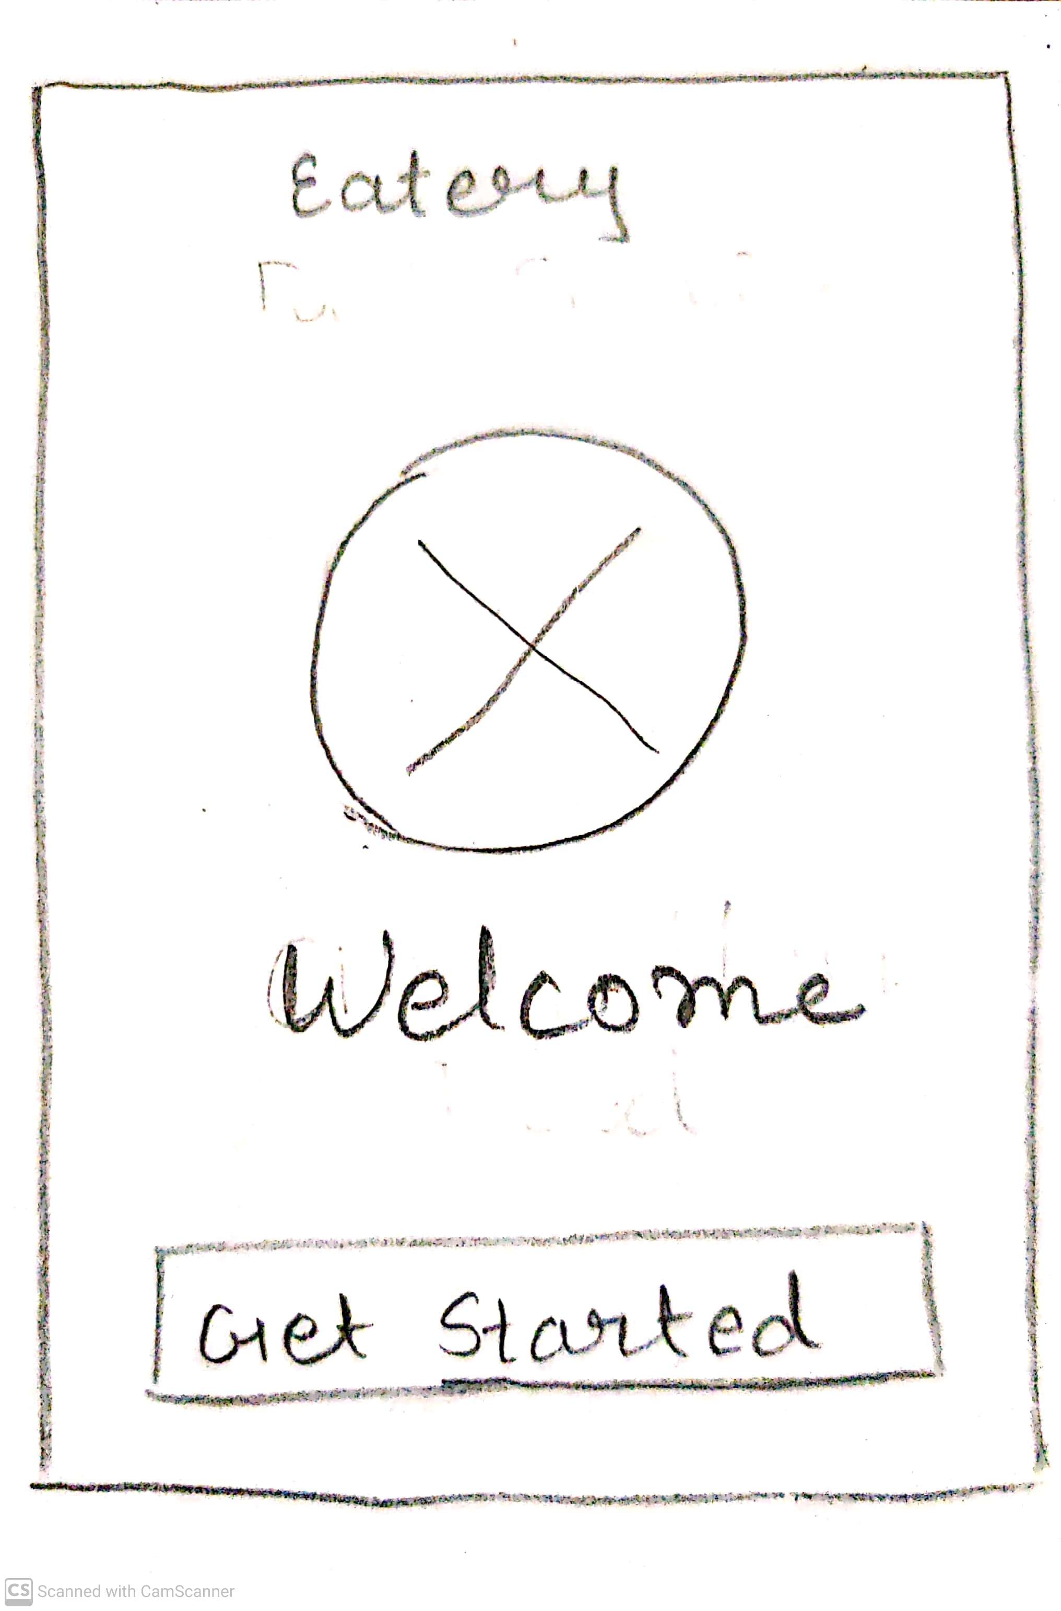
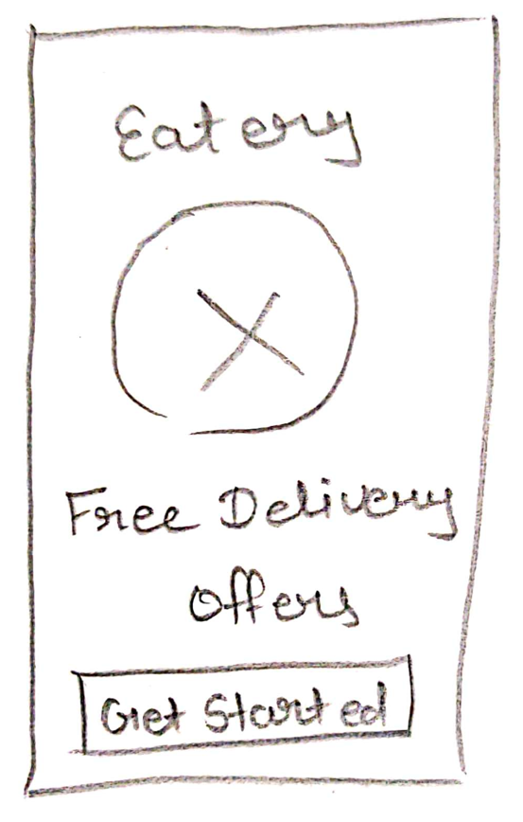
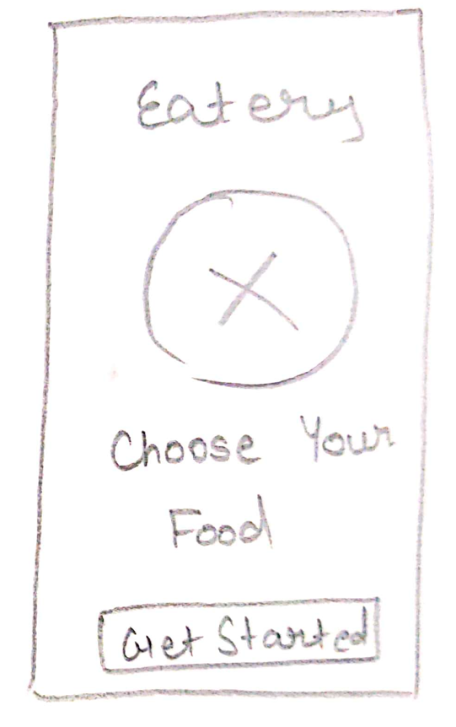
Welcome Page
Display pages for first time users after downloading the app.
Notes:
© Copyright UpGrad Education Pvt. Ltd. All rights reserved

Slide 39
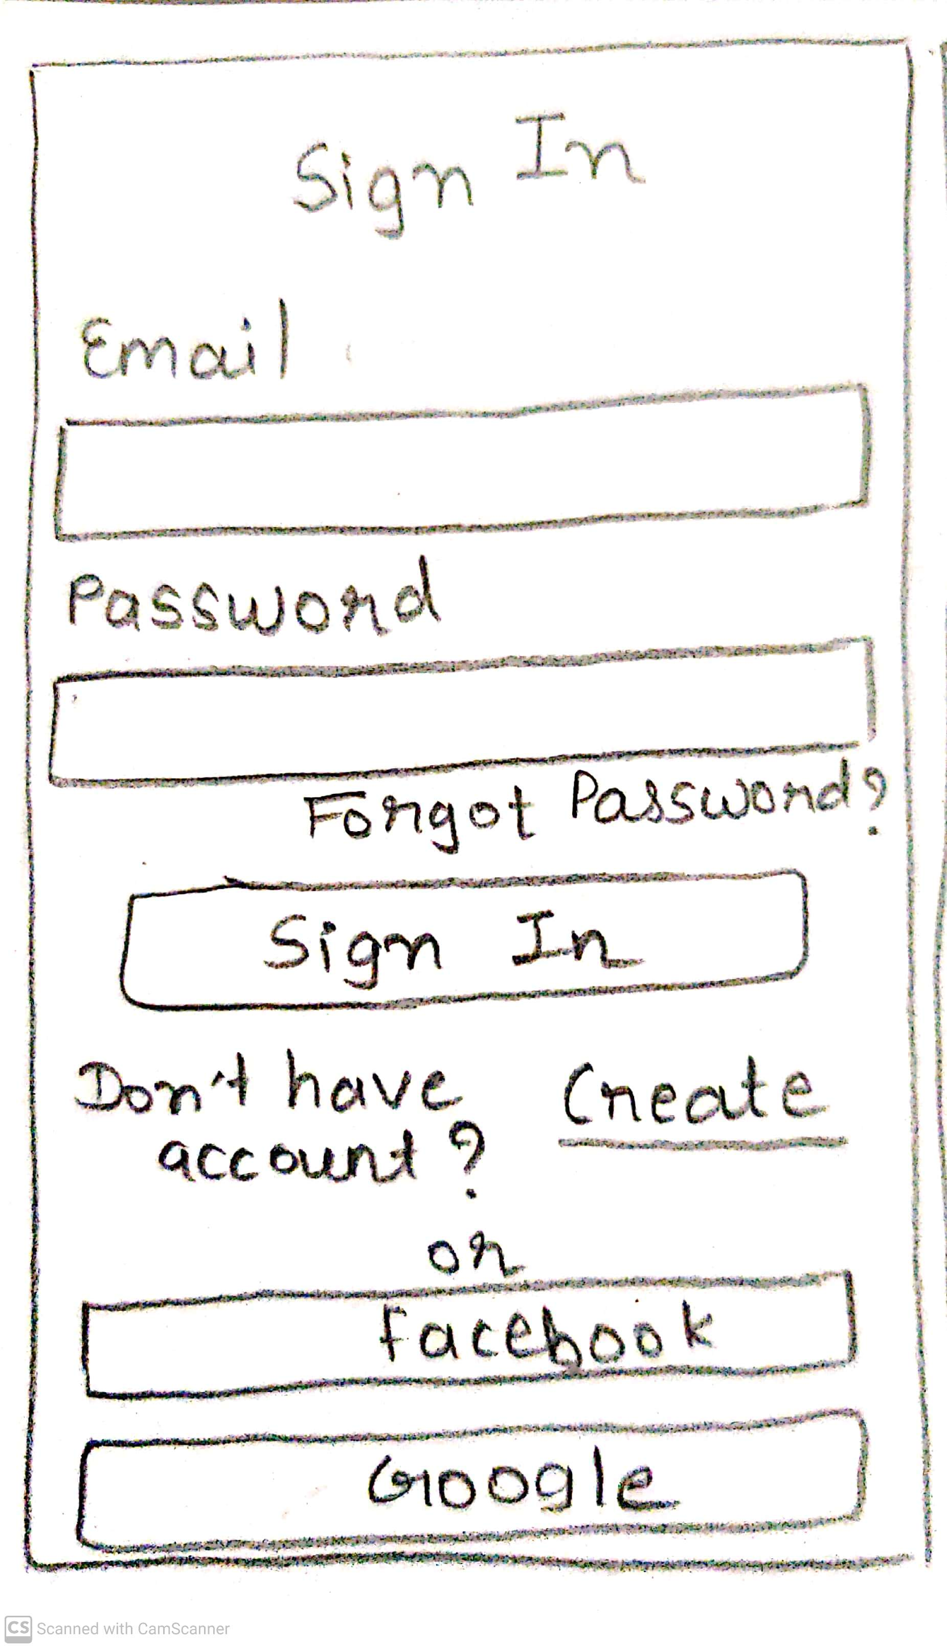
Sign In Page
Sign In page to sign in using your email id and password. And can also use google id or Facebook with forgot password button.
Notes:
© Copyright UpGrad Education Pvt. Ltd. All rights reserved

Slide 40
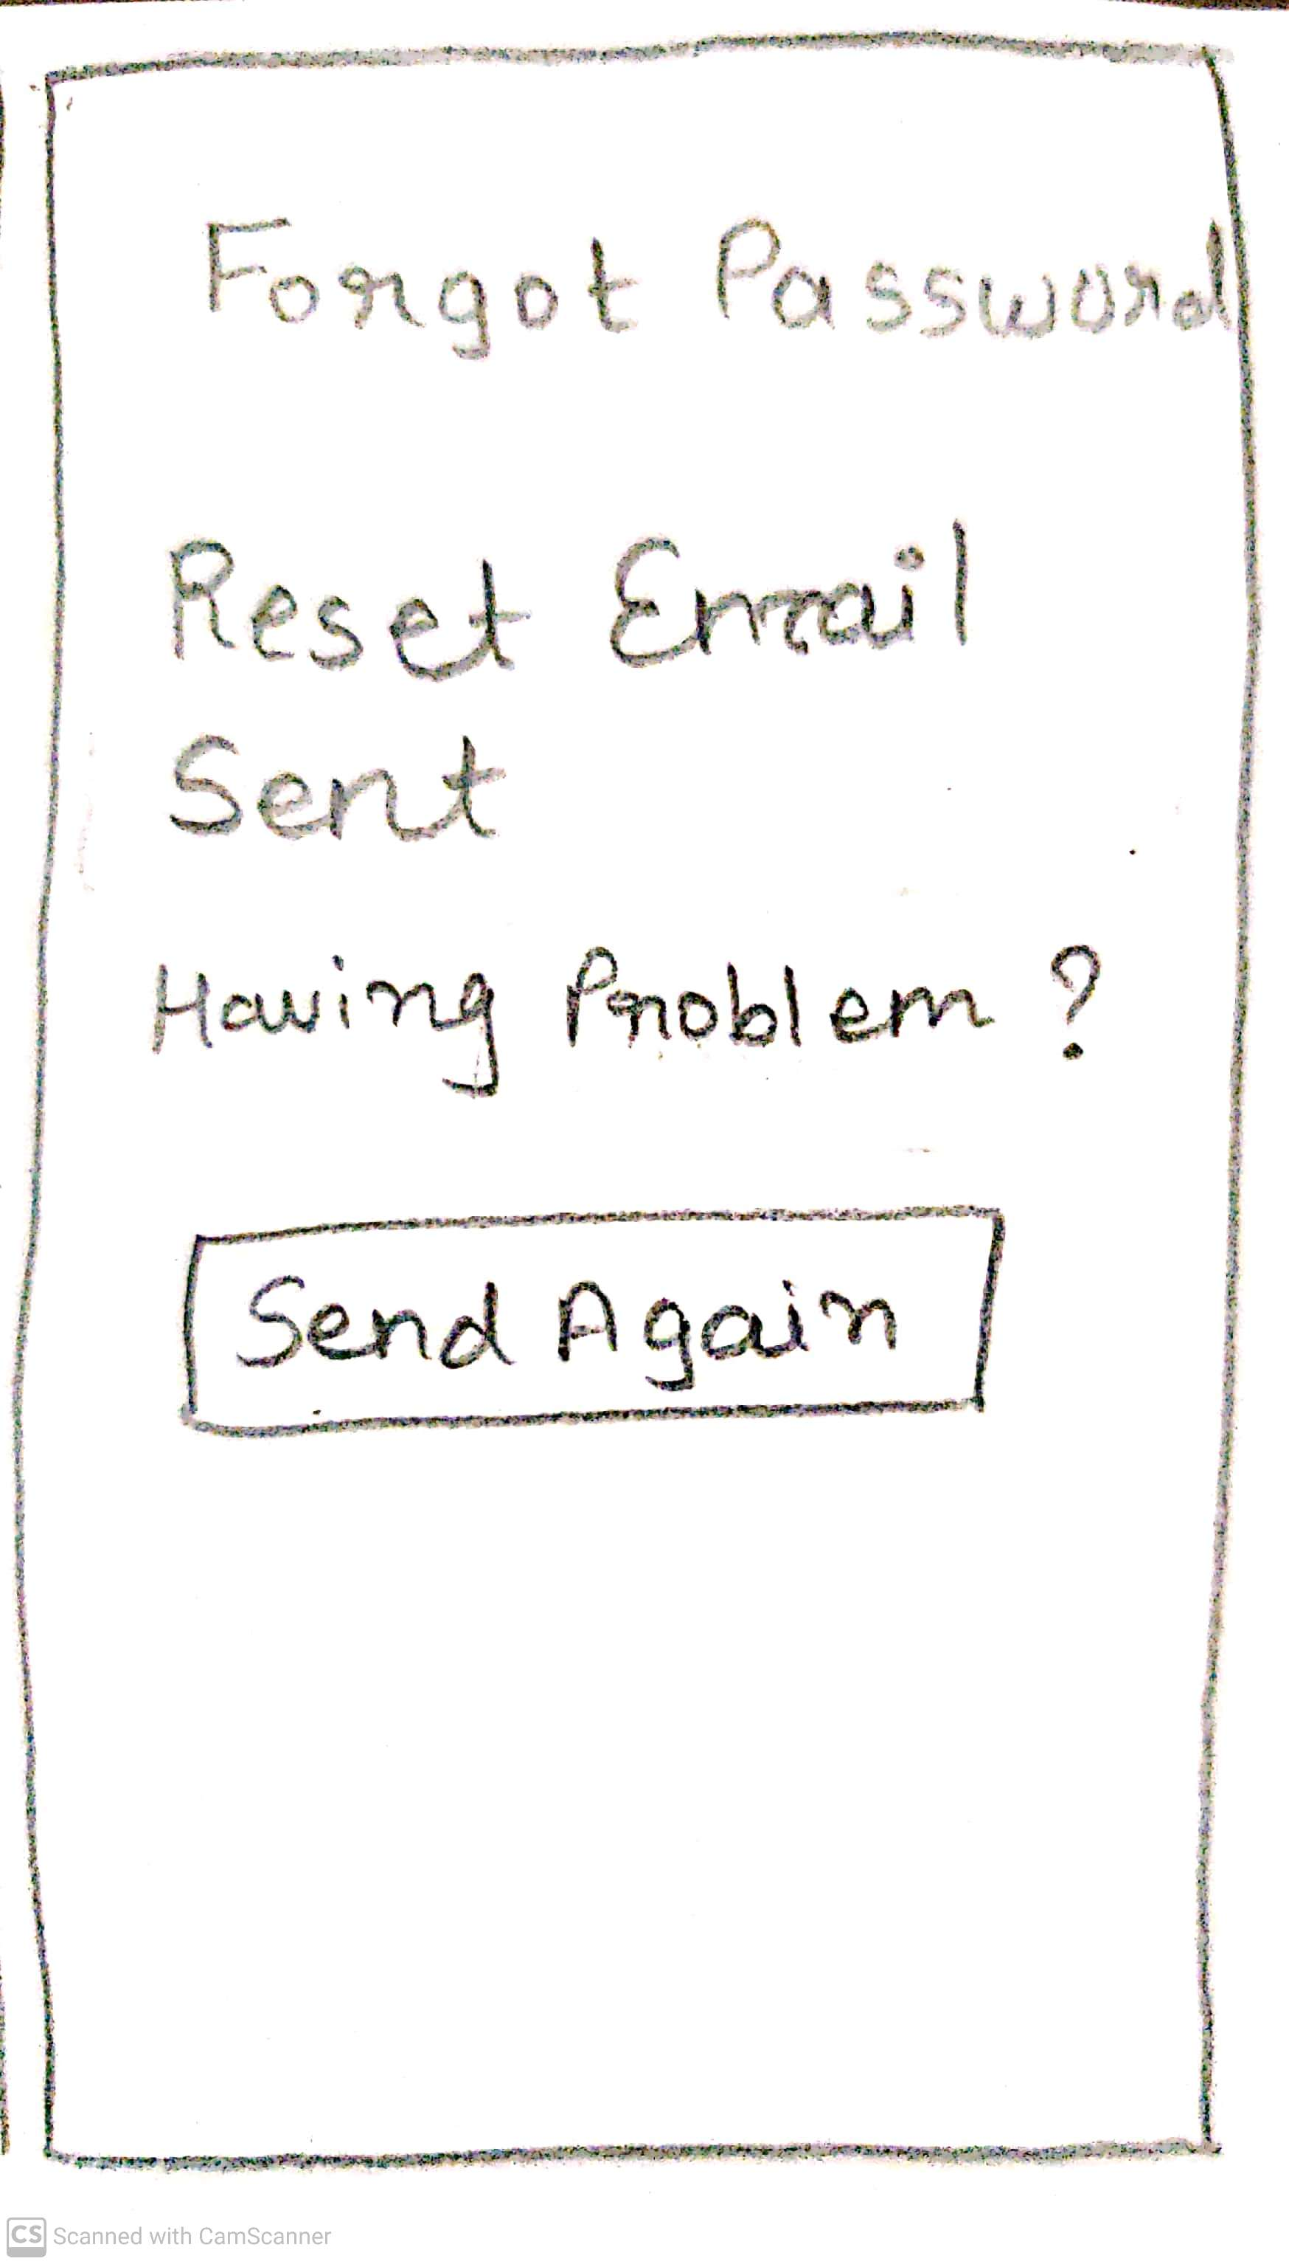
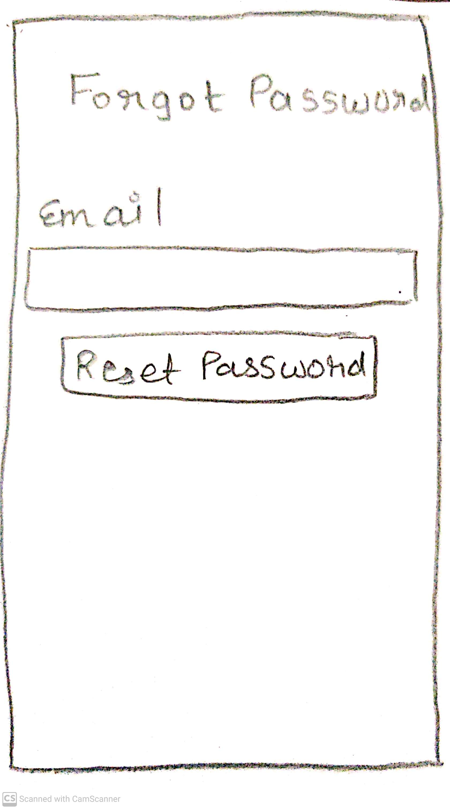
Forgot Password Page
Forgot password page in which we ask for an email to send a link to reset the password.
Reset email sent a page to notify a user and has a button to resend if they haven’t received in the first place.
Notes:
© Copyright UpGrad Education Pvt. Ltd. All rights reserved

Slide 41
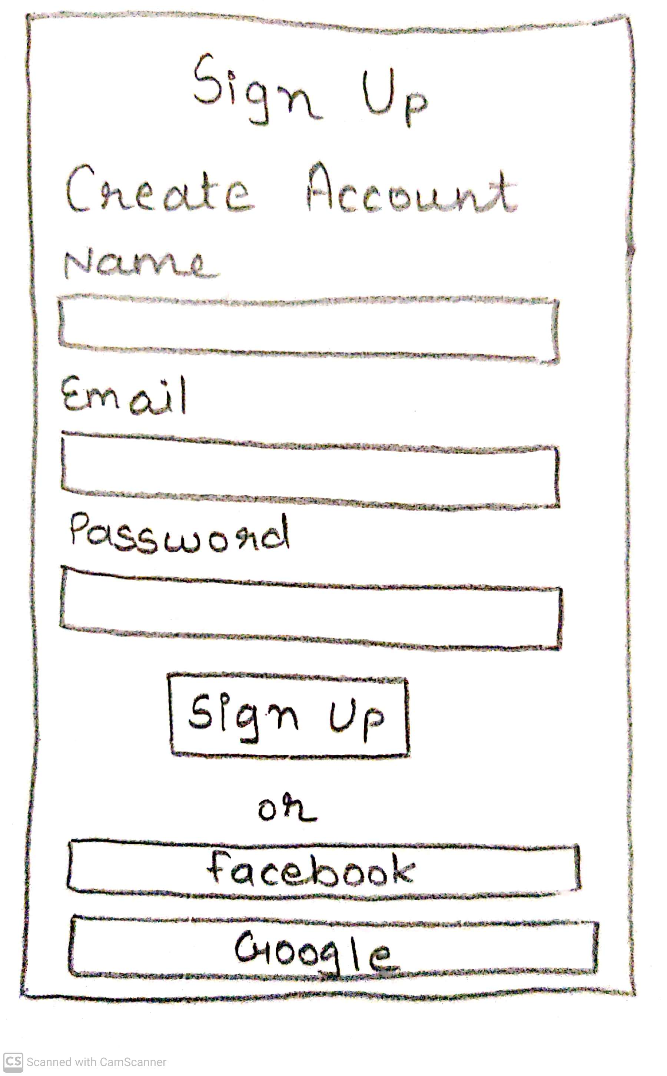
Sign Up Page
Sign up page to create an account. It consists of a full name, email address and password and there are also another options to sign up with Facebook and Google ID.
Notes:
© Copyright UpGrad Education Pvt. Ltd. All rights reserved

Slide 42
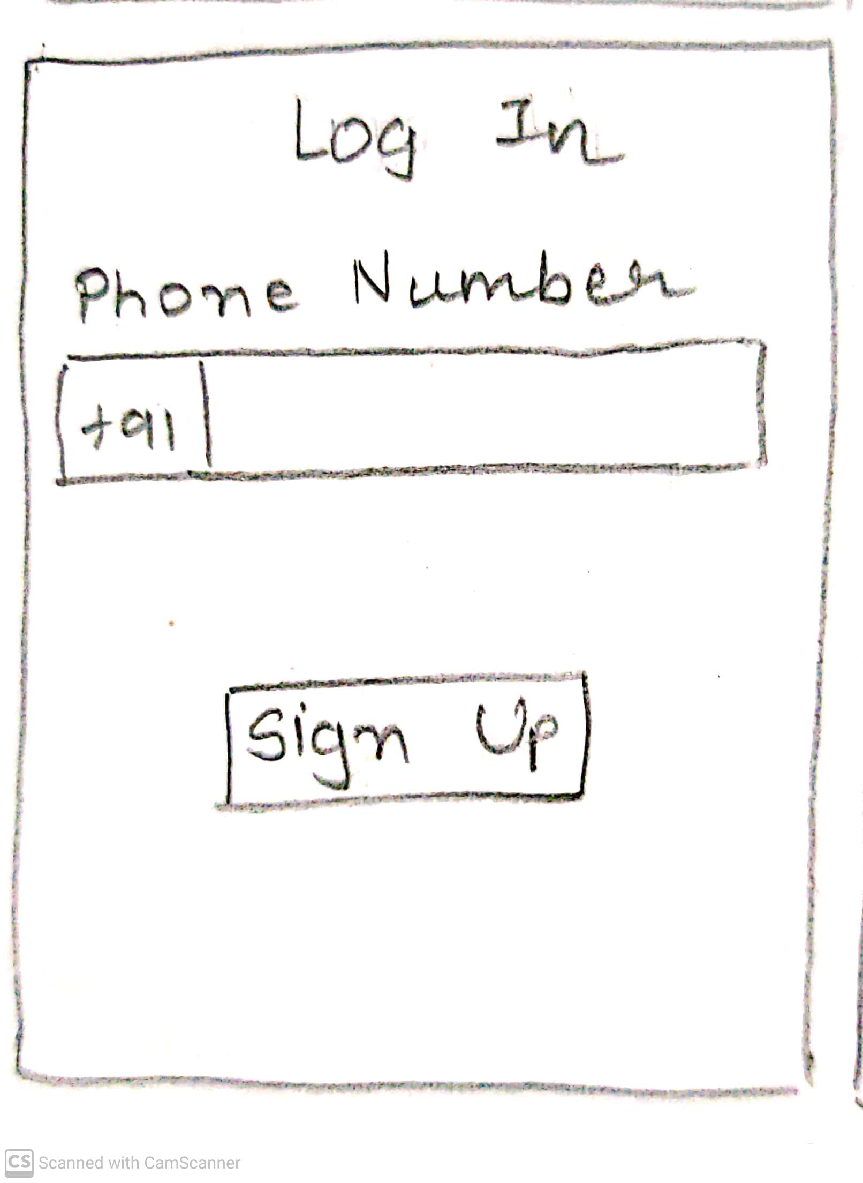
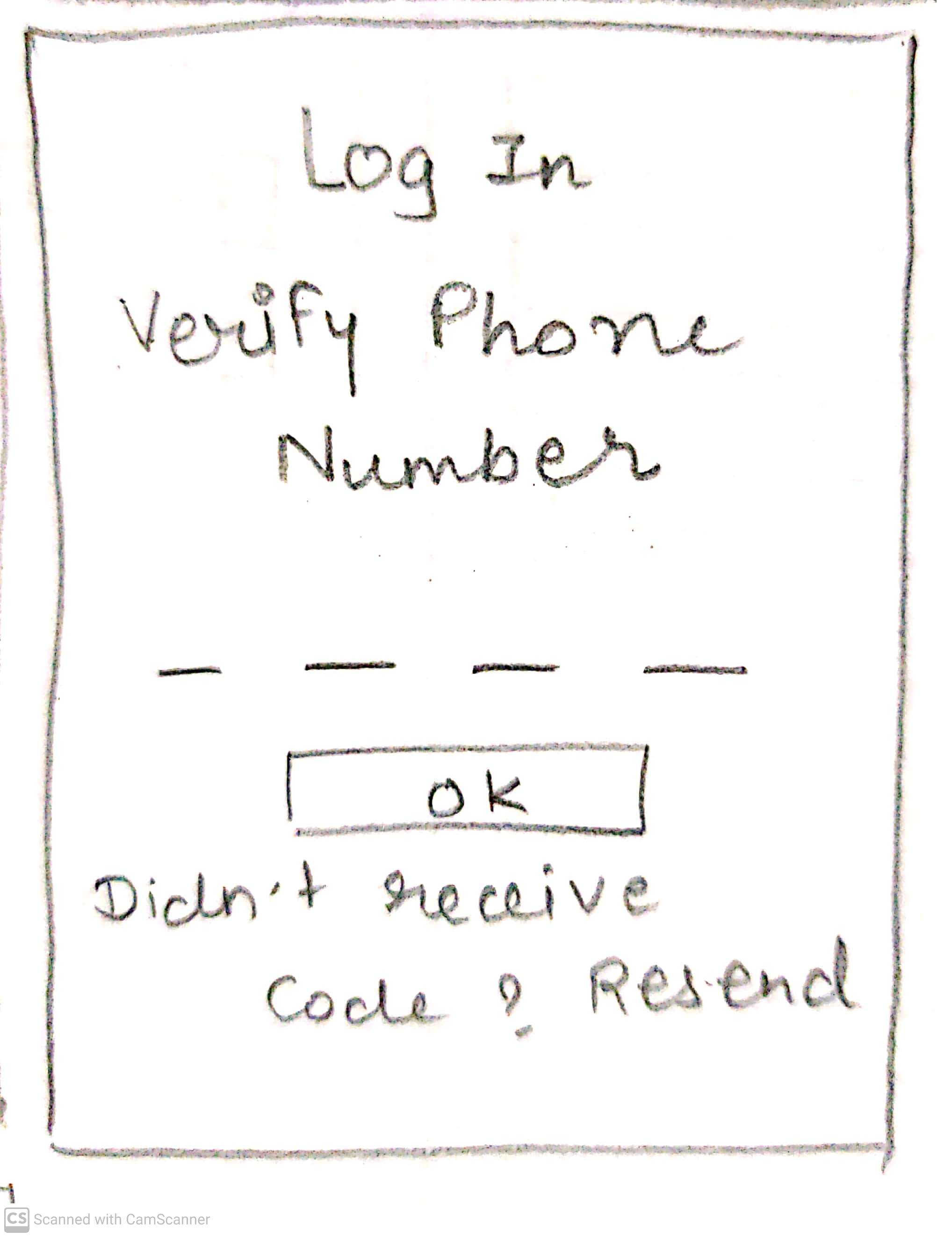
Log In Page
Login page using phone number
Verify phone number page using SMS sent on number.
Notes:
© Copyright UpGrad Education Pvt. Ltd. All rights reserved

Slide 43
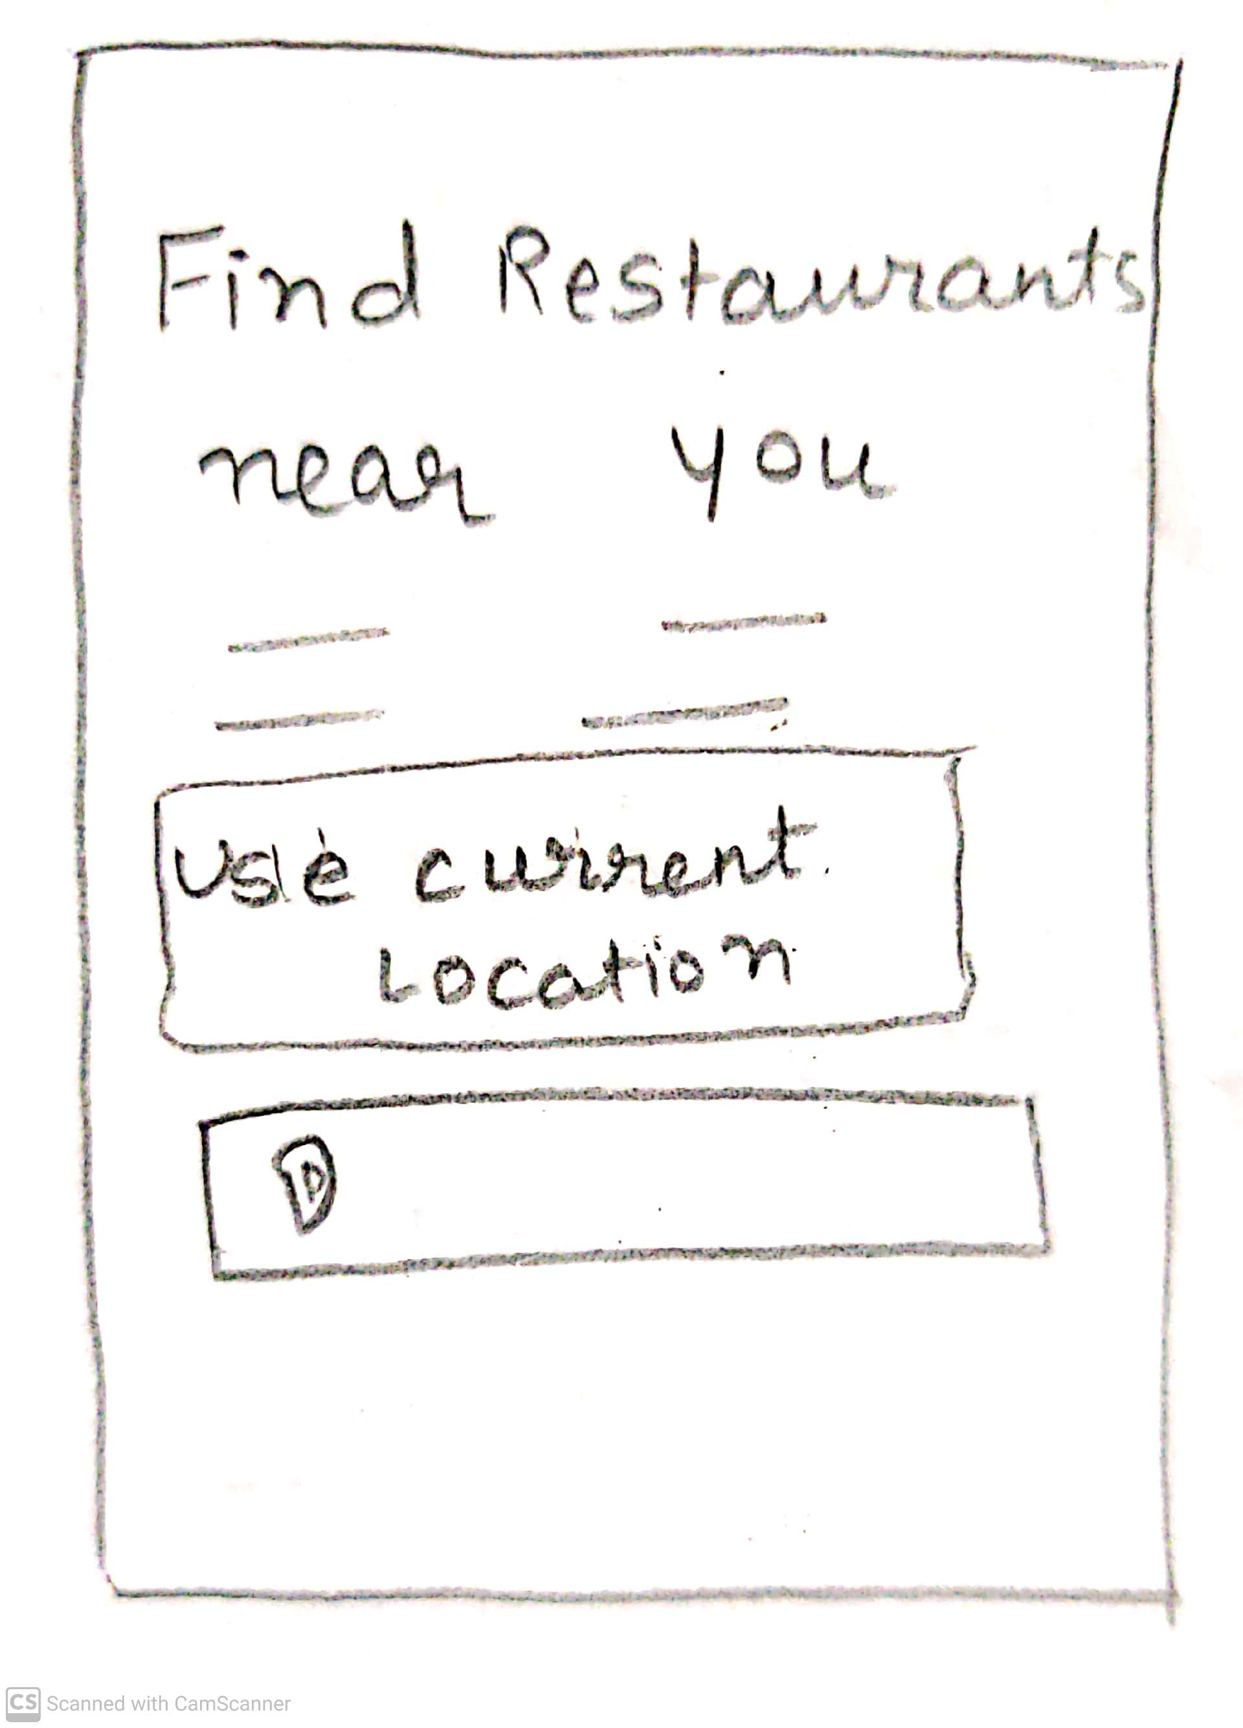
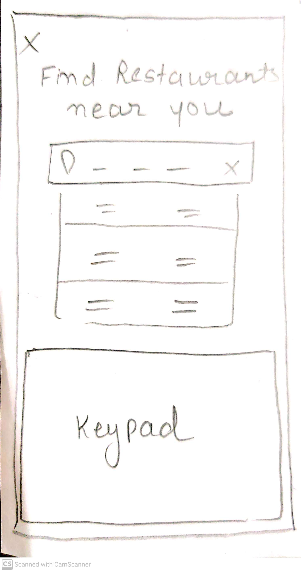
Near By Restaurant Page
Access location - Can find the restaurants near you by accessing your location
Notes:
© Copyright UpGrad Education Pvt. Ltd. All rights reserved

Slide 44
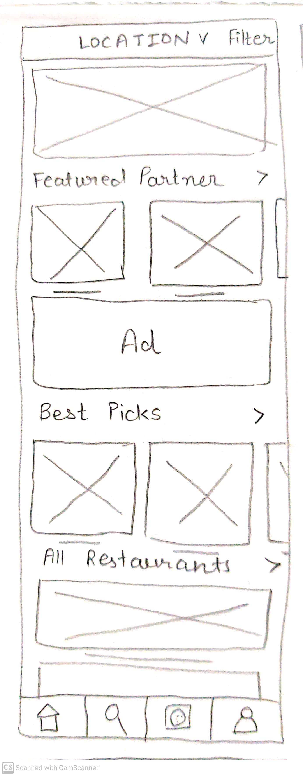
Home Page
Home page - homepage consists of all your top-rated restaurants and dishes with ratings and also listed offers.
Notes:
© Copyright UpGrad Education Pvt. Ltd. All rights reserved

Slide 45
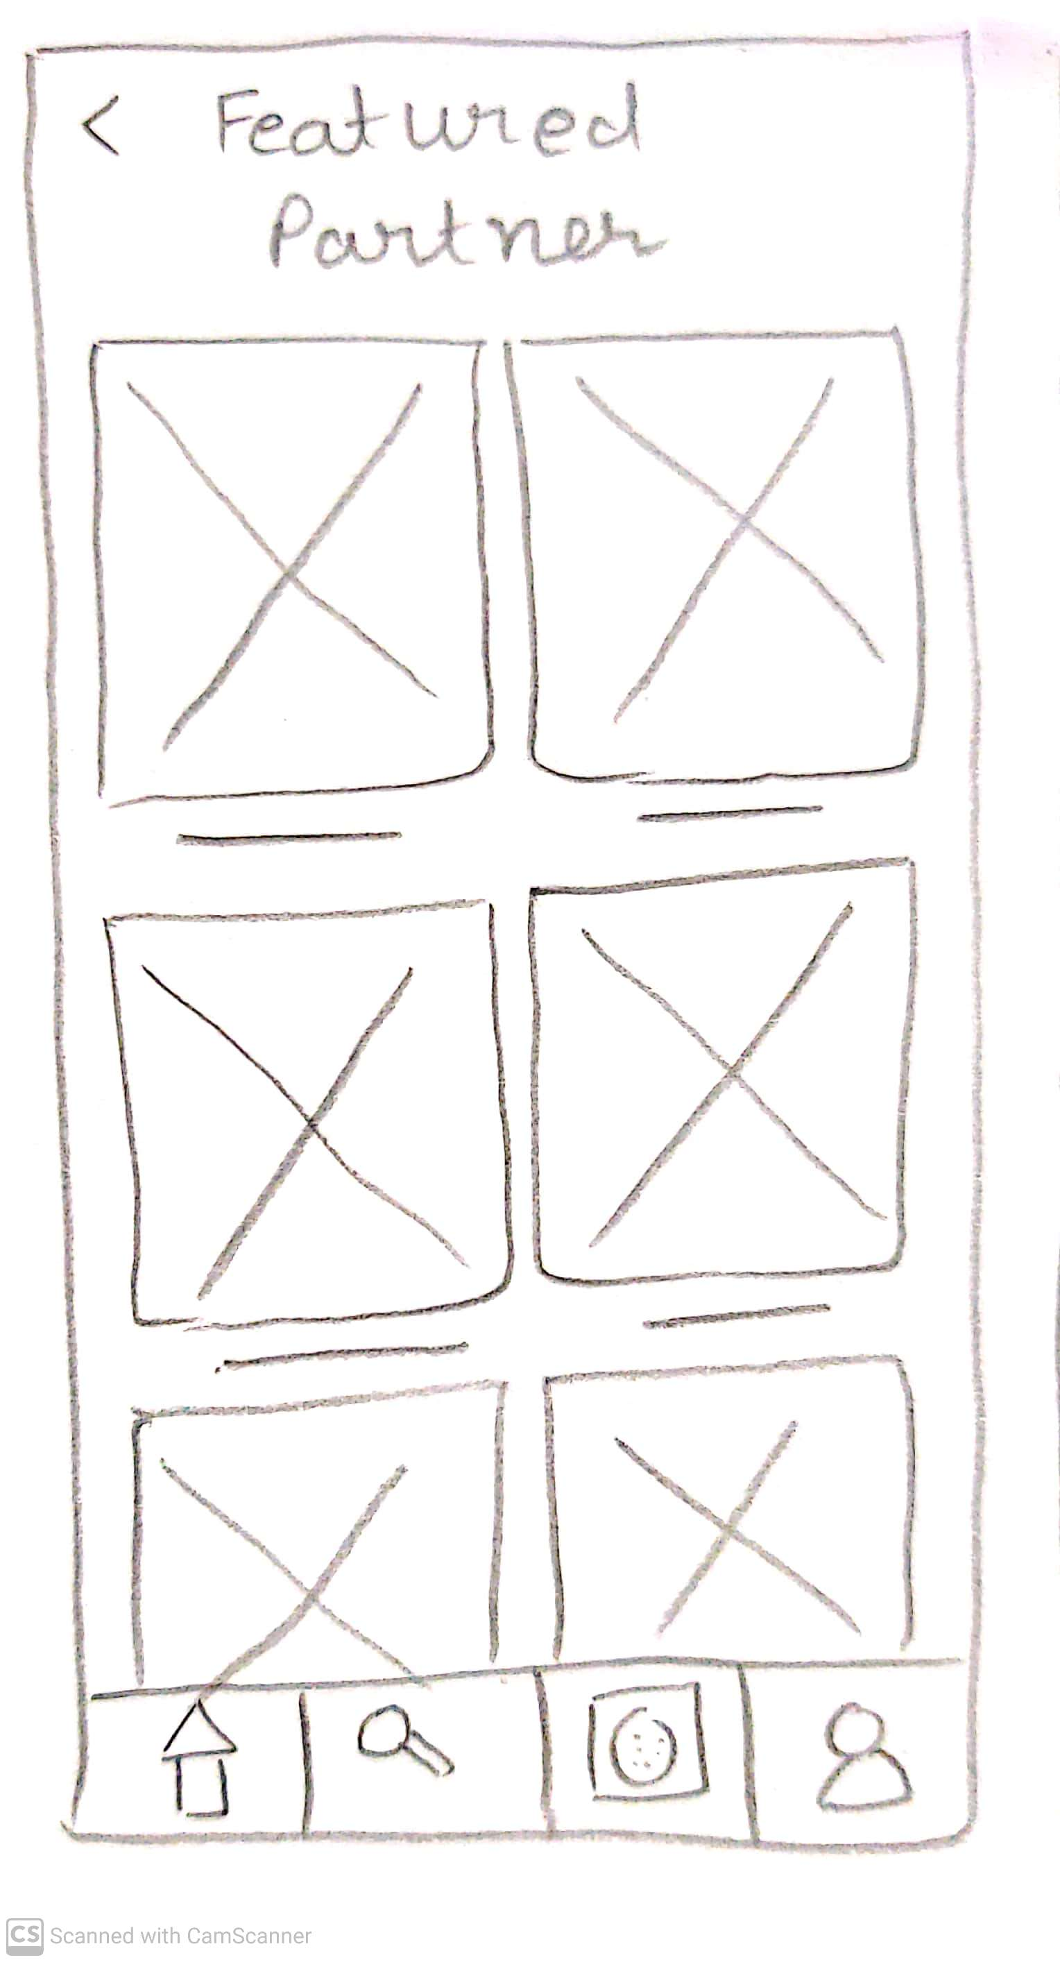
Featured Partner Page
Featured partner more specifically for users to find top-rated restaurants also helping them to find their favorite restaurants.
Notes:
© Copyright UpGrad Education Pvt. Ltd. All rights reserved

Slide 46
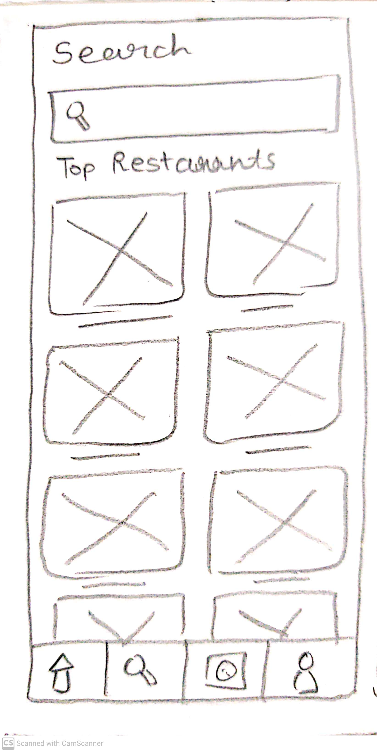
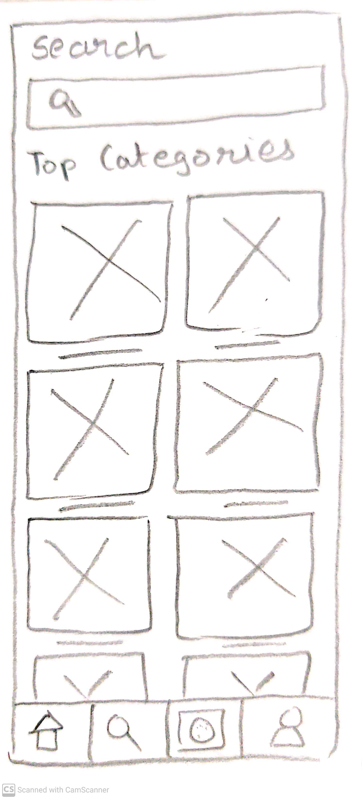
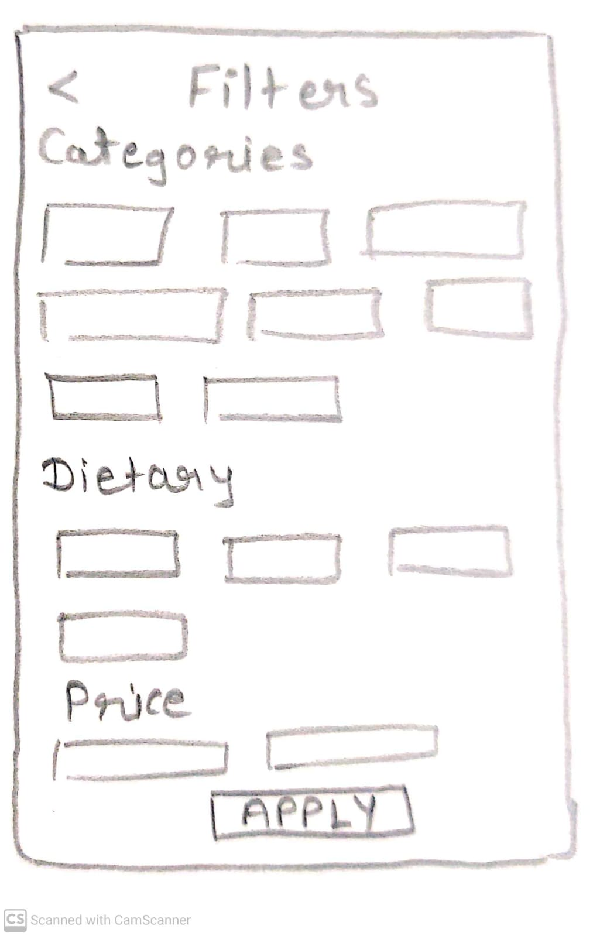
Search Restaurant Page
An additional page has been given to search your favorite cuisine, restaurant.
Notes:
© Copyright UpGrad Education Pvt. Ltd. All rights reserved

Slide 47
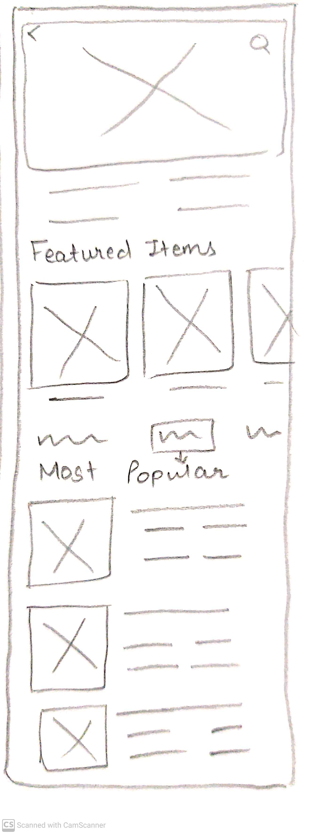
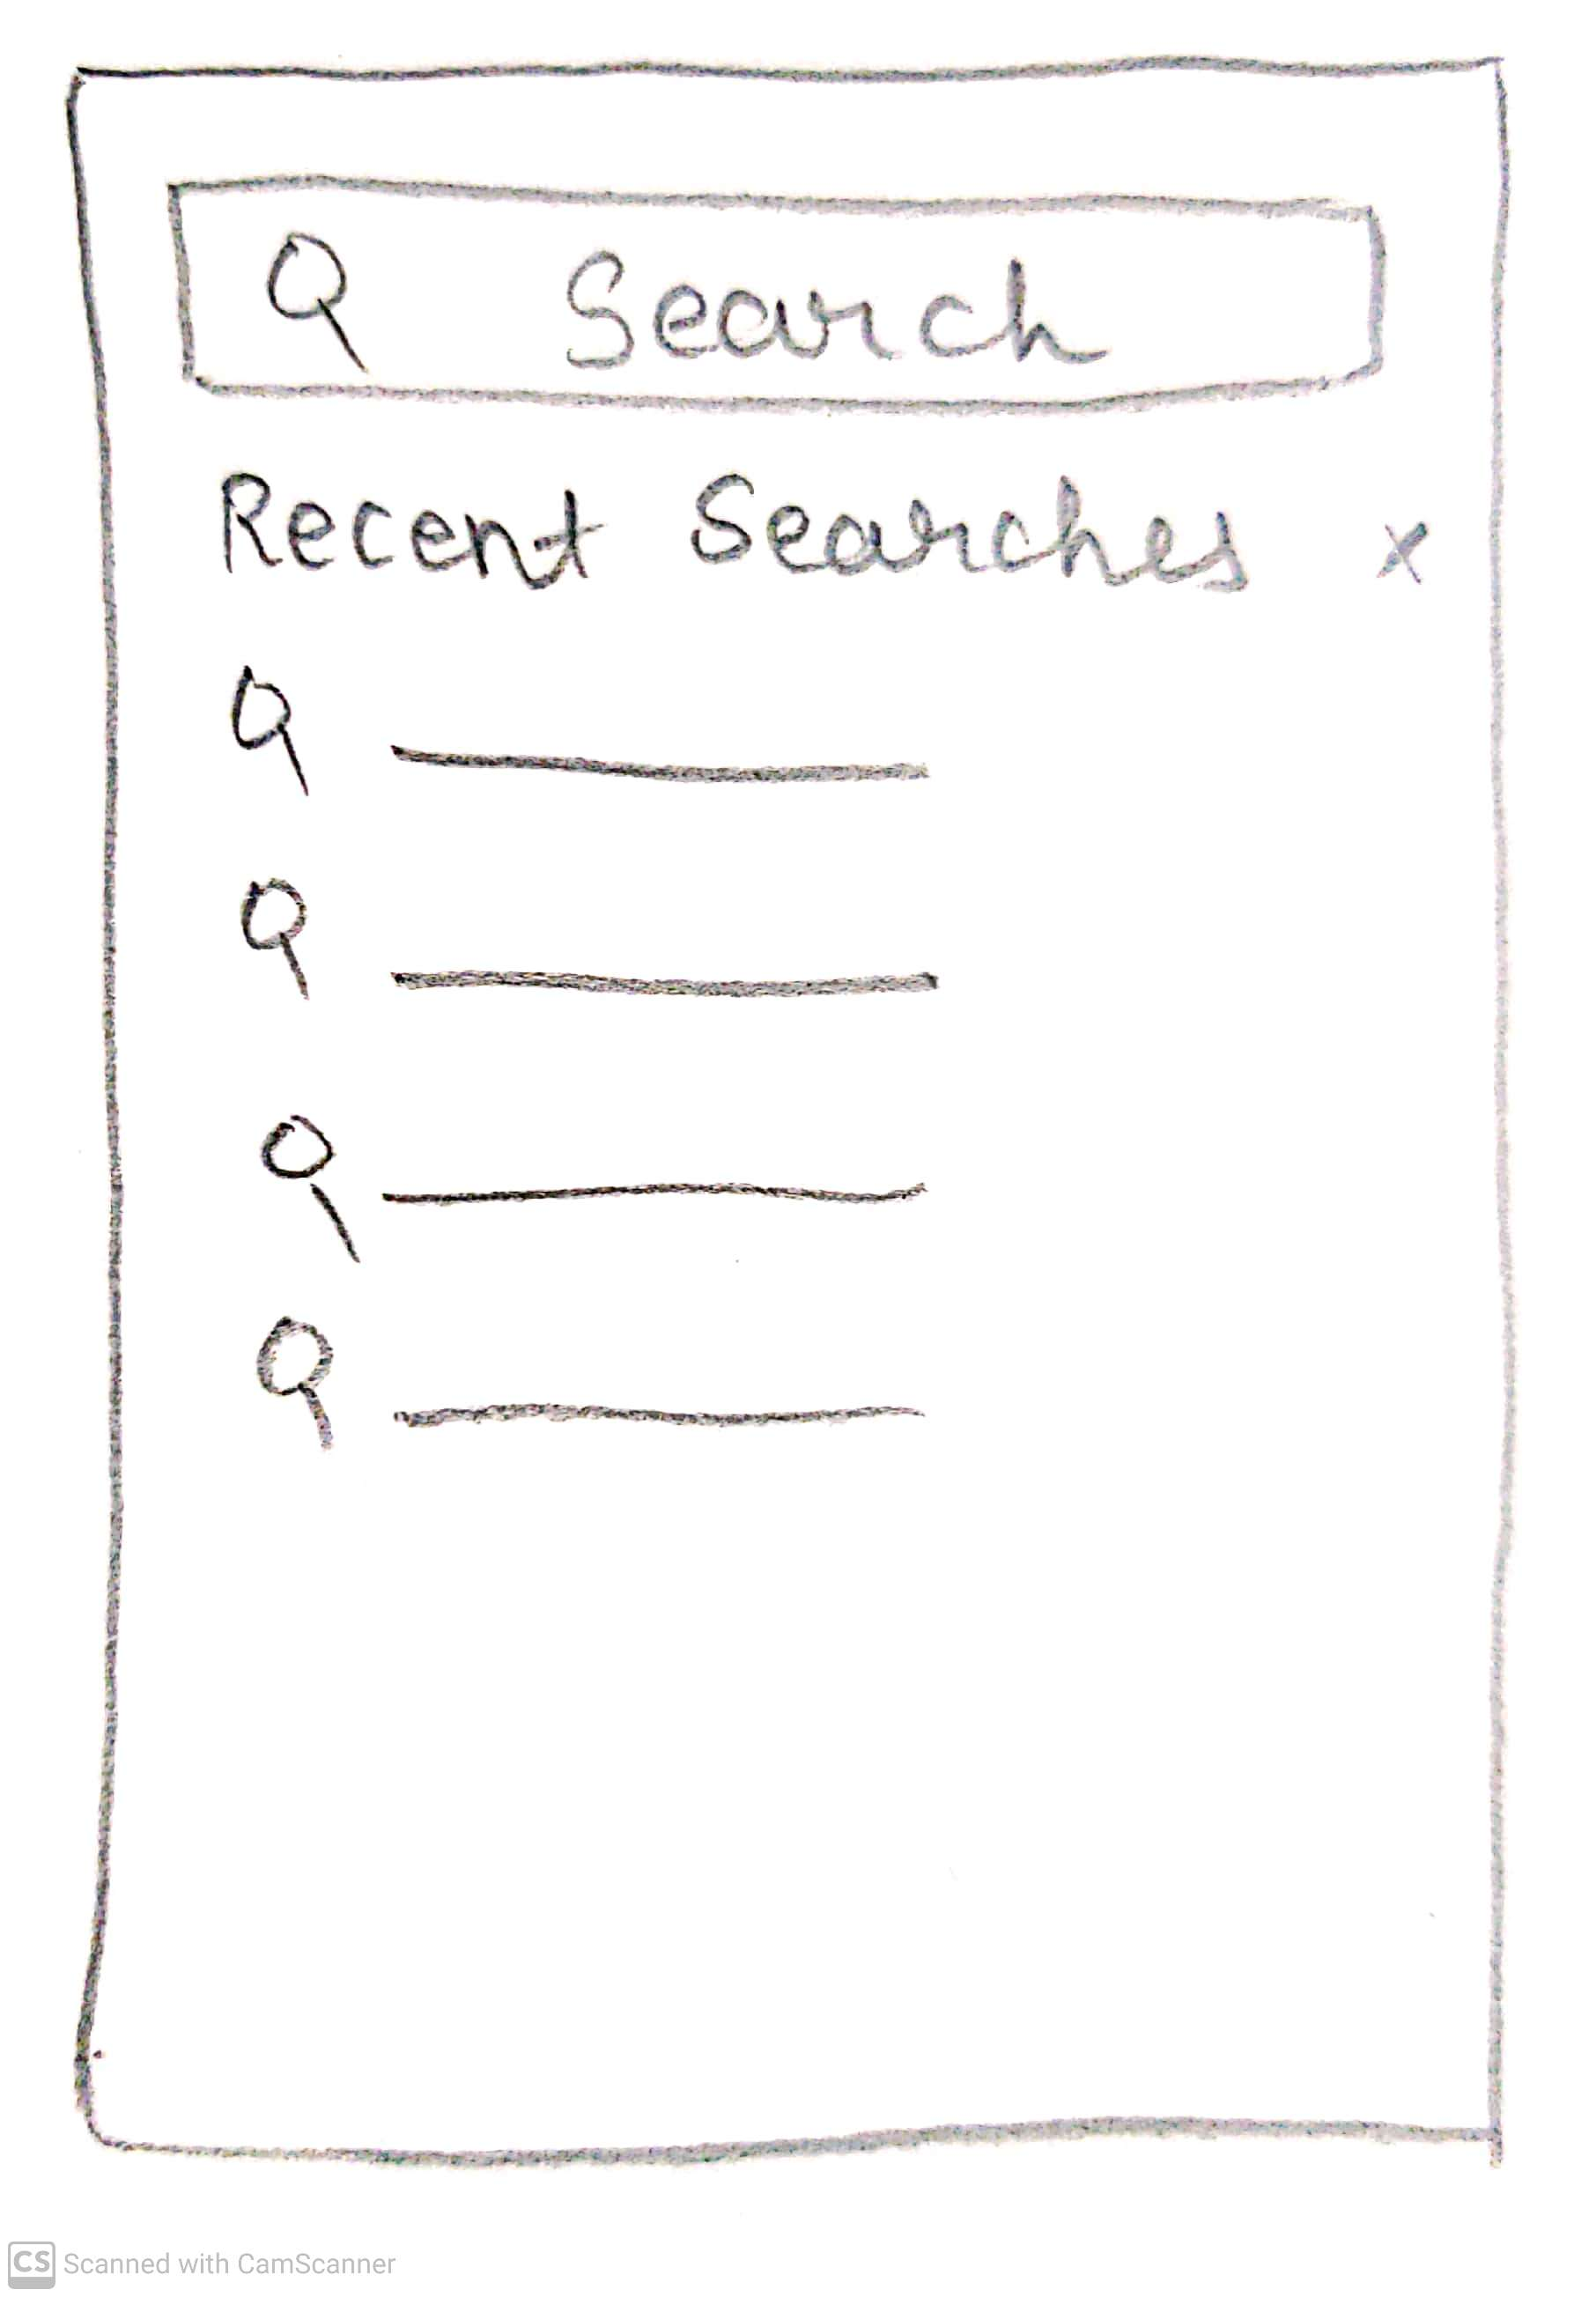
Search Food Page
Search particular food item and it's result page containing multiple restaurants.
Notes:
© Copyright UpGrad Education Pvt. Ltd. All rights reserved

Slide 48
Single Restaurant Page
This page consists of all the dishes of particular restaurants with their prices and ratings..
Notes:
© Copyright UpGrad Education Pvt. Ltd. All rights reserved

Slide 49
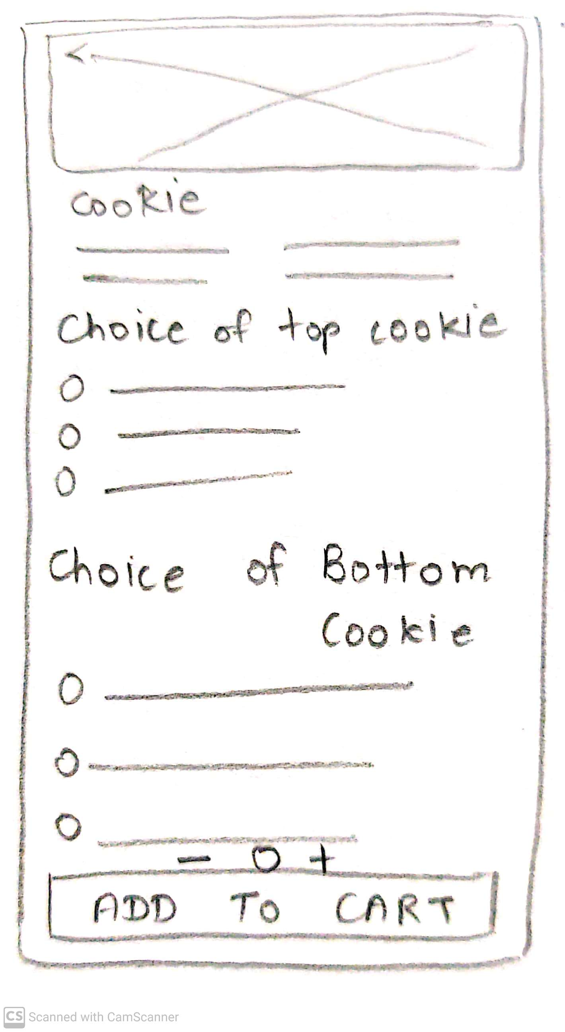
Add To Order Page
Selecting item you can select item and customize it according to the choices available.
Notes:
© Copyright UpGrad Education Pvt. Ltd. All rights reserved

Slide 50
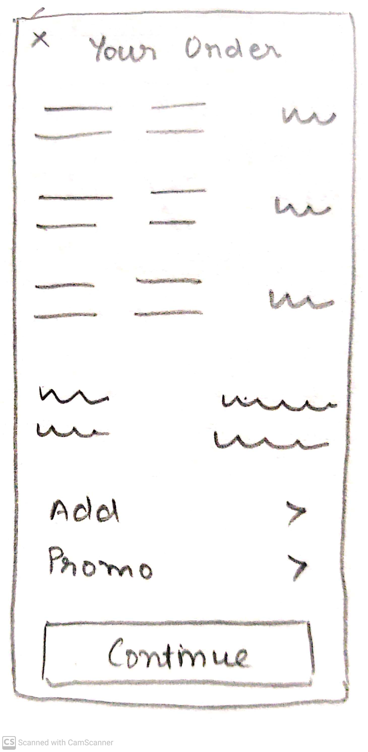
Your Order Page
Your Orders - You can view your selected items and bill amount
Notes:
© Copyright UpGrad Education Pvt. Ltd. All rights reserved

Slide 51
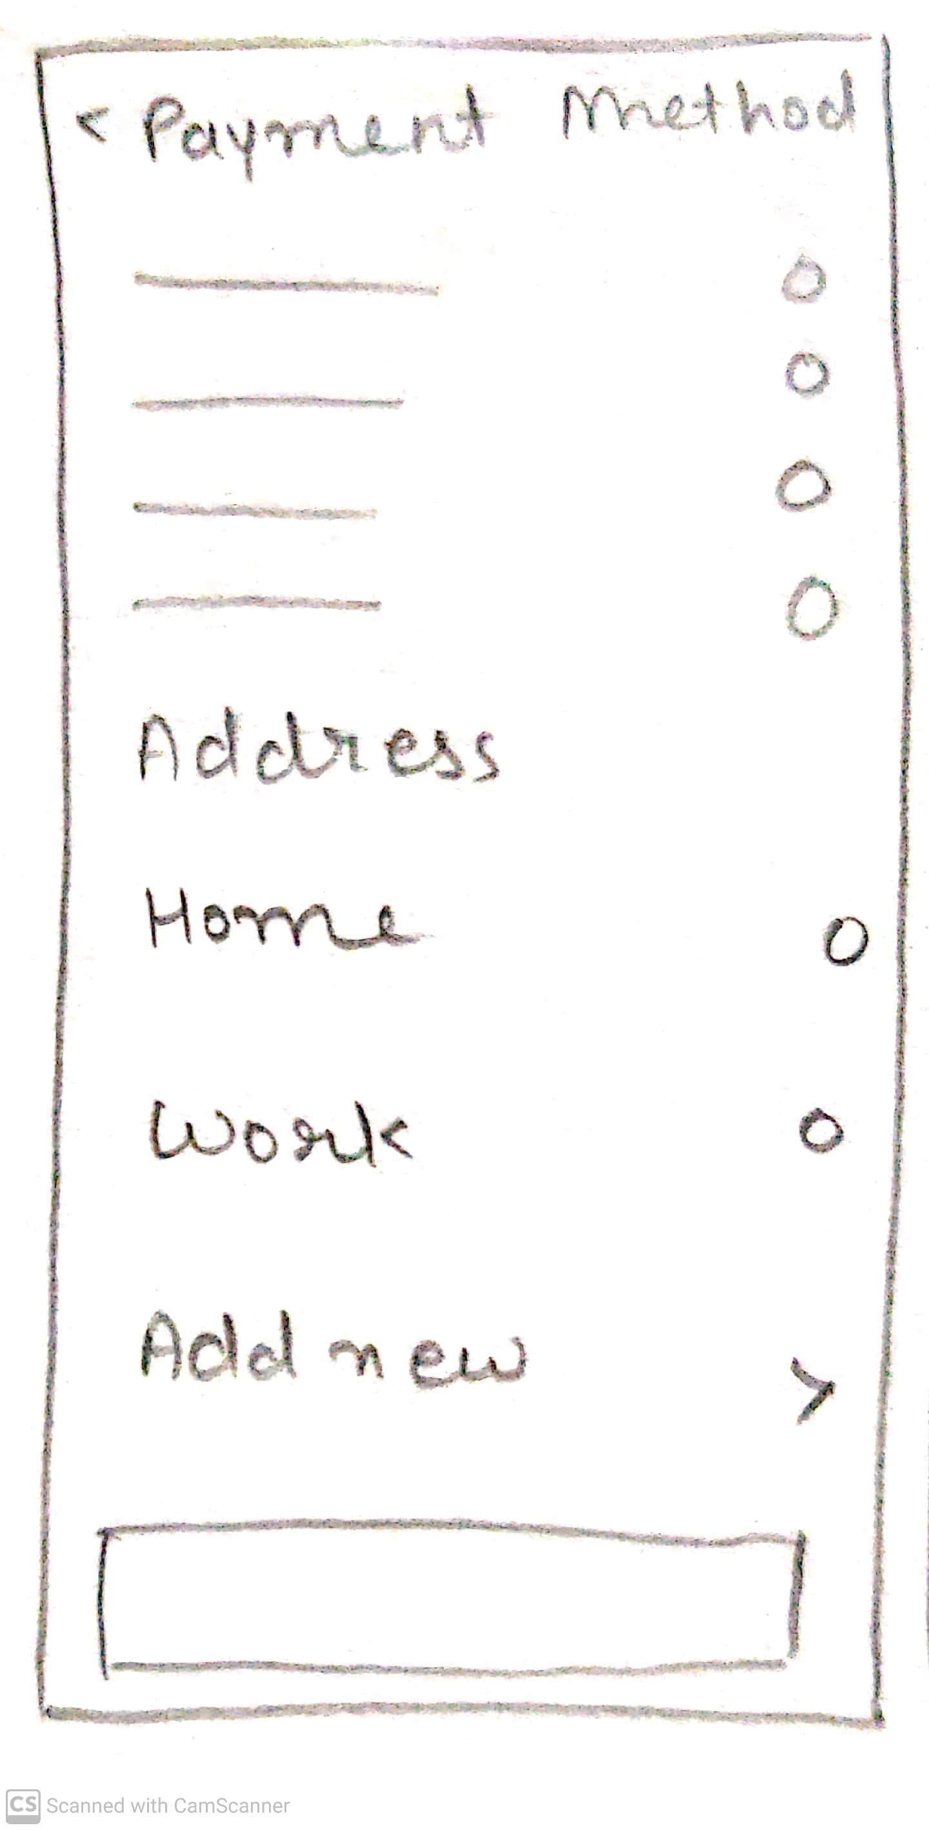
Payment Page
Payment Method & Address You can select the comfortable payment option and select any address from your saved addresses. You can also add new address
Notes:
© Copyright UpGrad Education Pvt. Ltd. All rights reserved

Slide 52
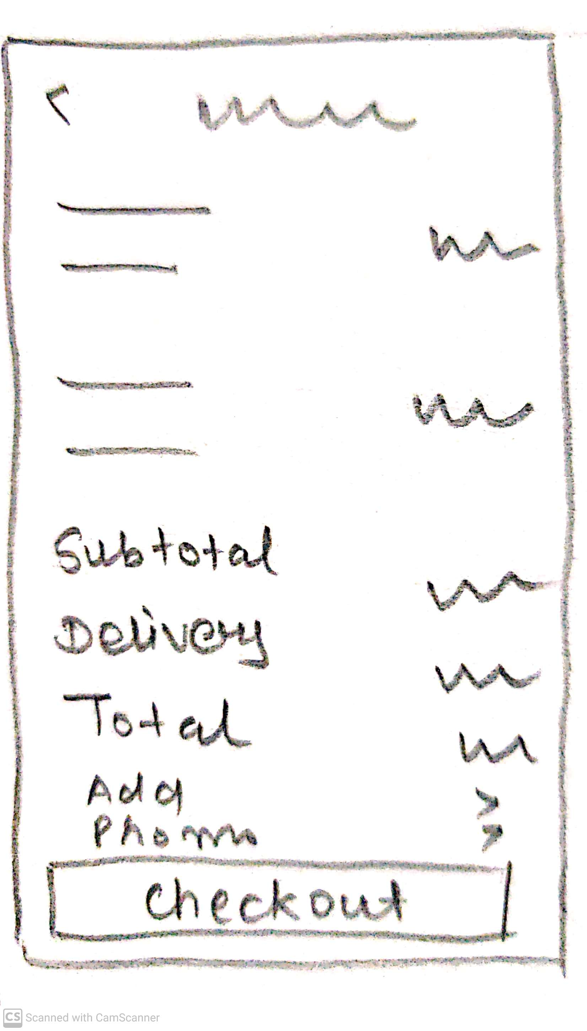
Confirm Order Page
Your order summary will be displayed then you have to click on continue to select the payment method
Notes:
© Copyright UpGrad Education Pvt. Ltd. All rights reserved

Slide 53
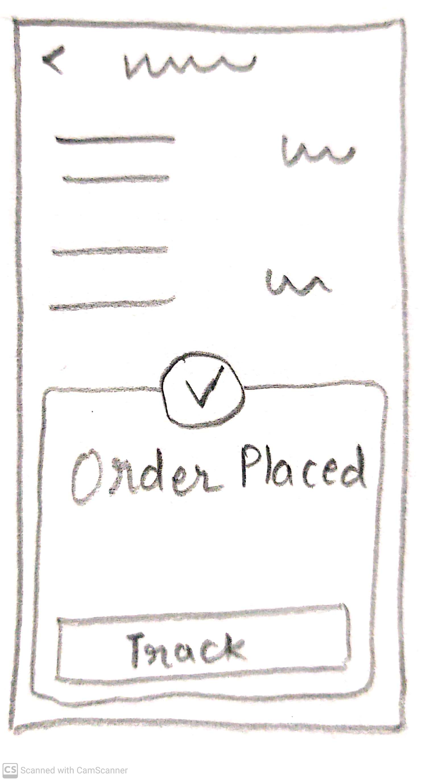
Order Confirmation Page
After clicking on check out button you will be get to the order completion page where you will be shown a pop-up that describes you place the order successfully and you can track your order.
Notes:
© Copyright UpGrad Education Pvt. Ltd. All rights reserved

Slide 54
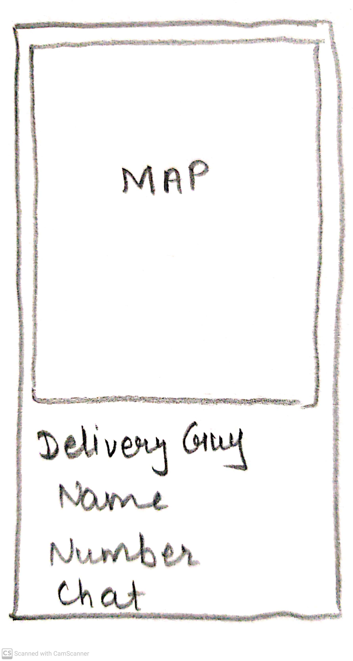
Delivery Agent Tracking Page
Track your order - in this, you will see a map, in which you can see the location of the delivery boy, his number, and a chat option
Notes:
© Copyright UpGrad Education Pvt. Ltd. All rights reserved

Slide 55
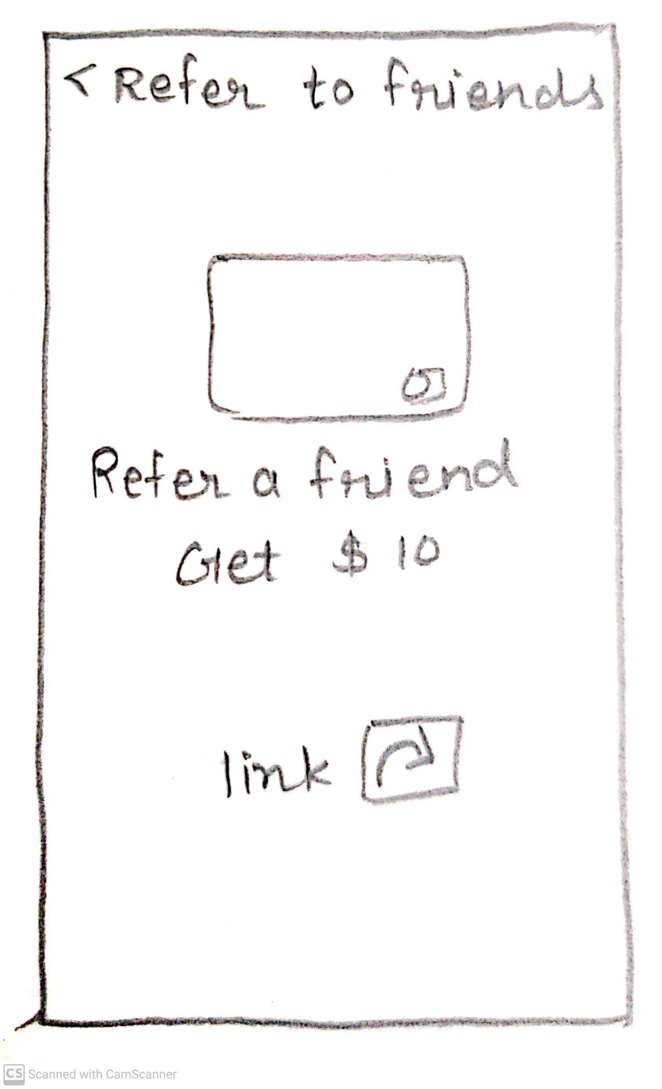
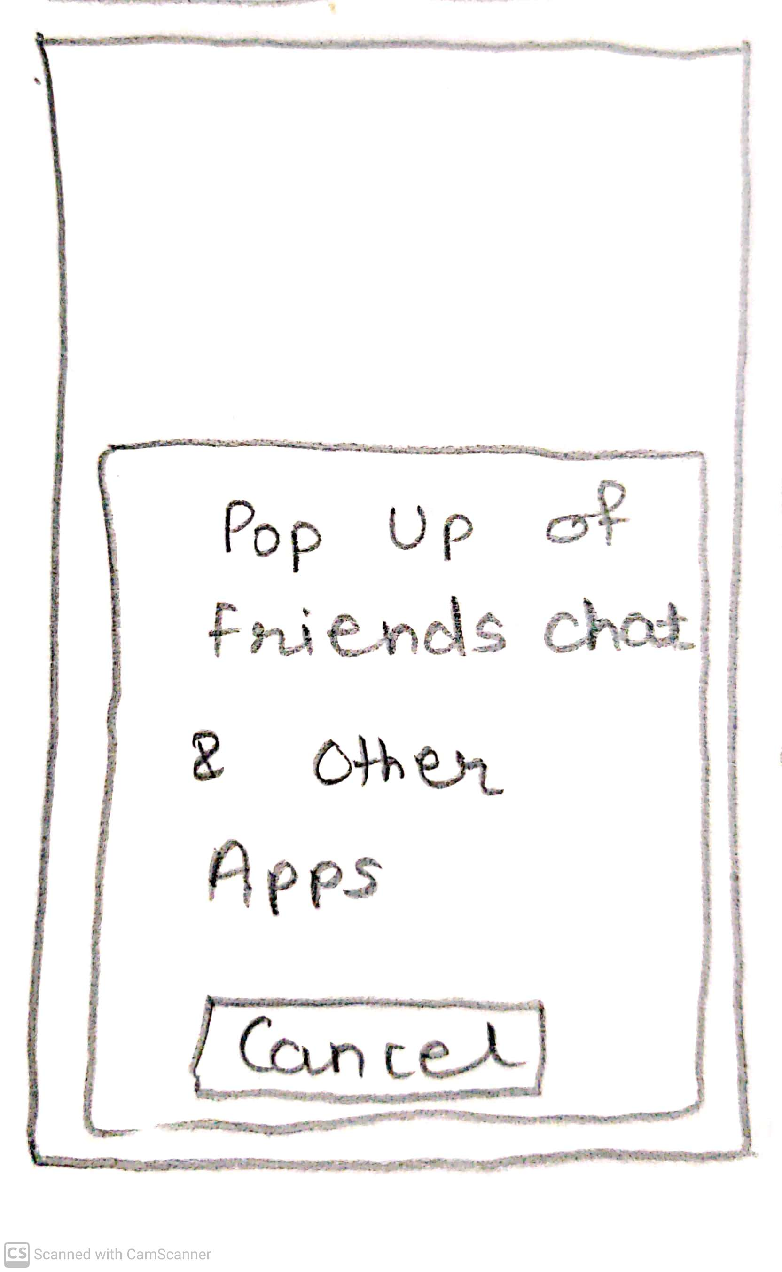
Referral Page
Referral the page is for helping your friend via referral and rewarding yourself out of it.
Notes:
© Copyright UpGrad Education Pvt. Ltd. All rights reserved

Slide 56
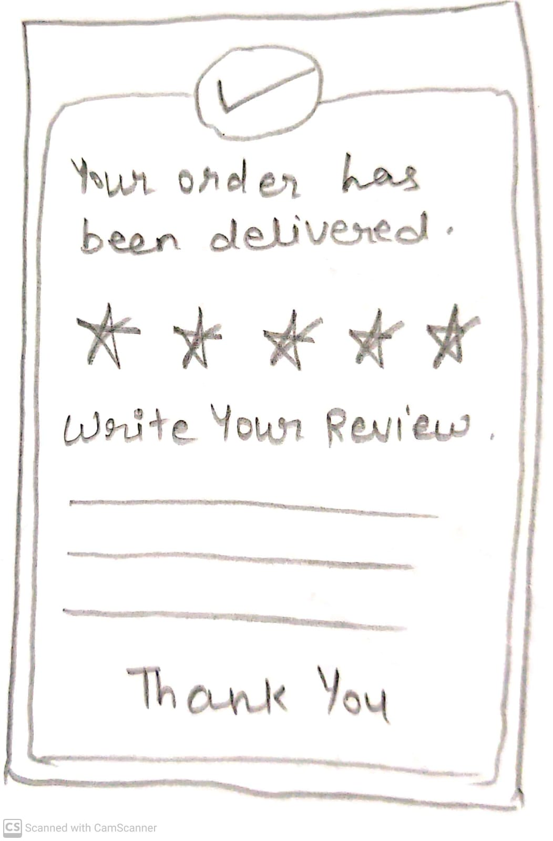
Rating Page
Rating and Review - after your order gets delivered, this screen will pop up, in which you can give rating and review
Notes:
© Copyright UpGrad Education Pvt. Ltd. All rights reserved

Slide 57
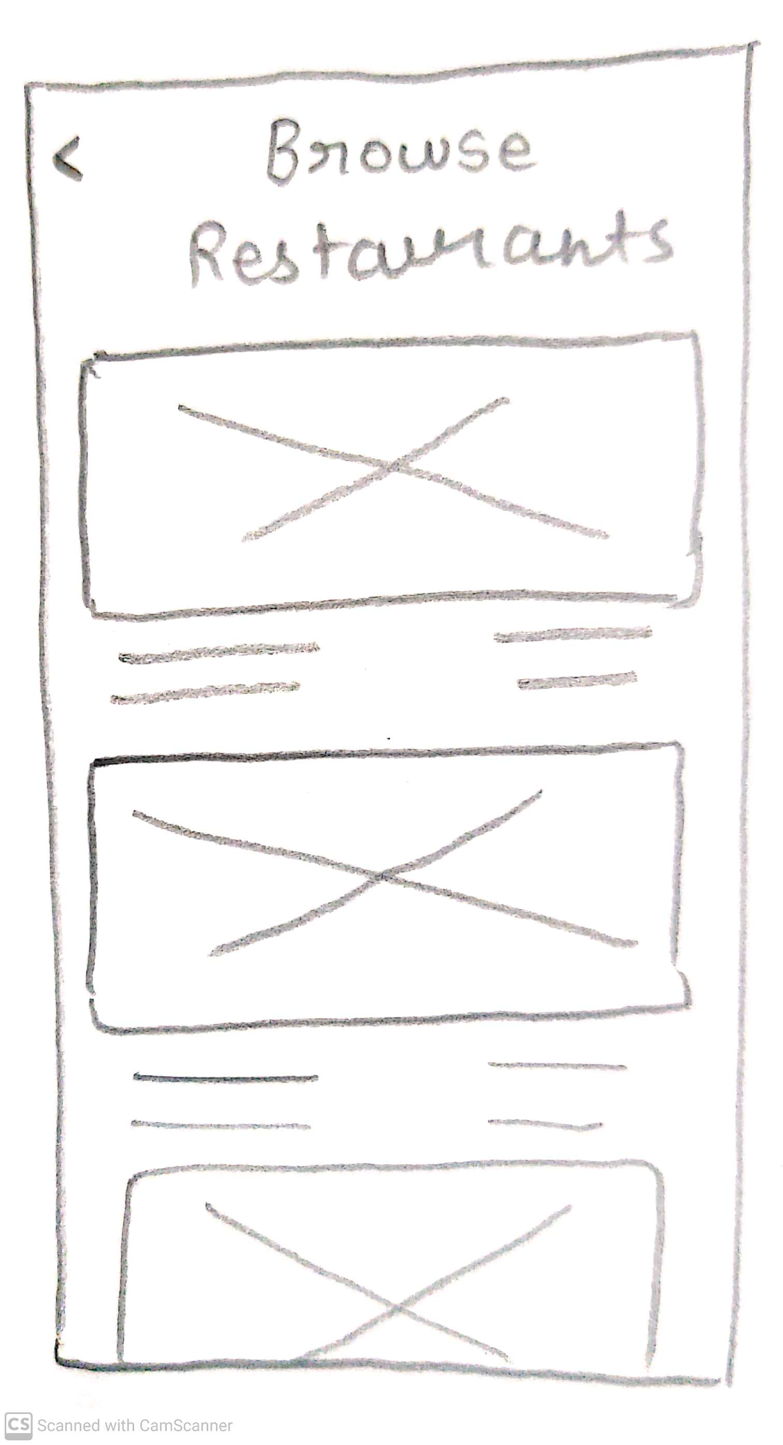
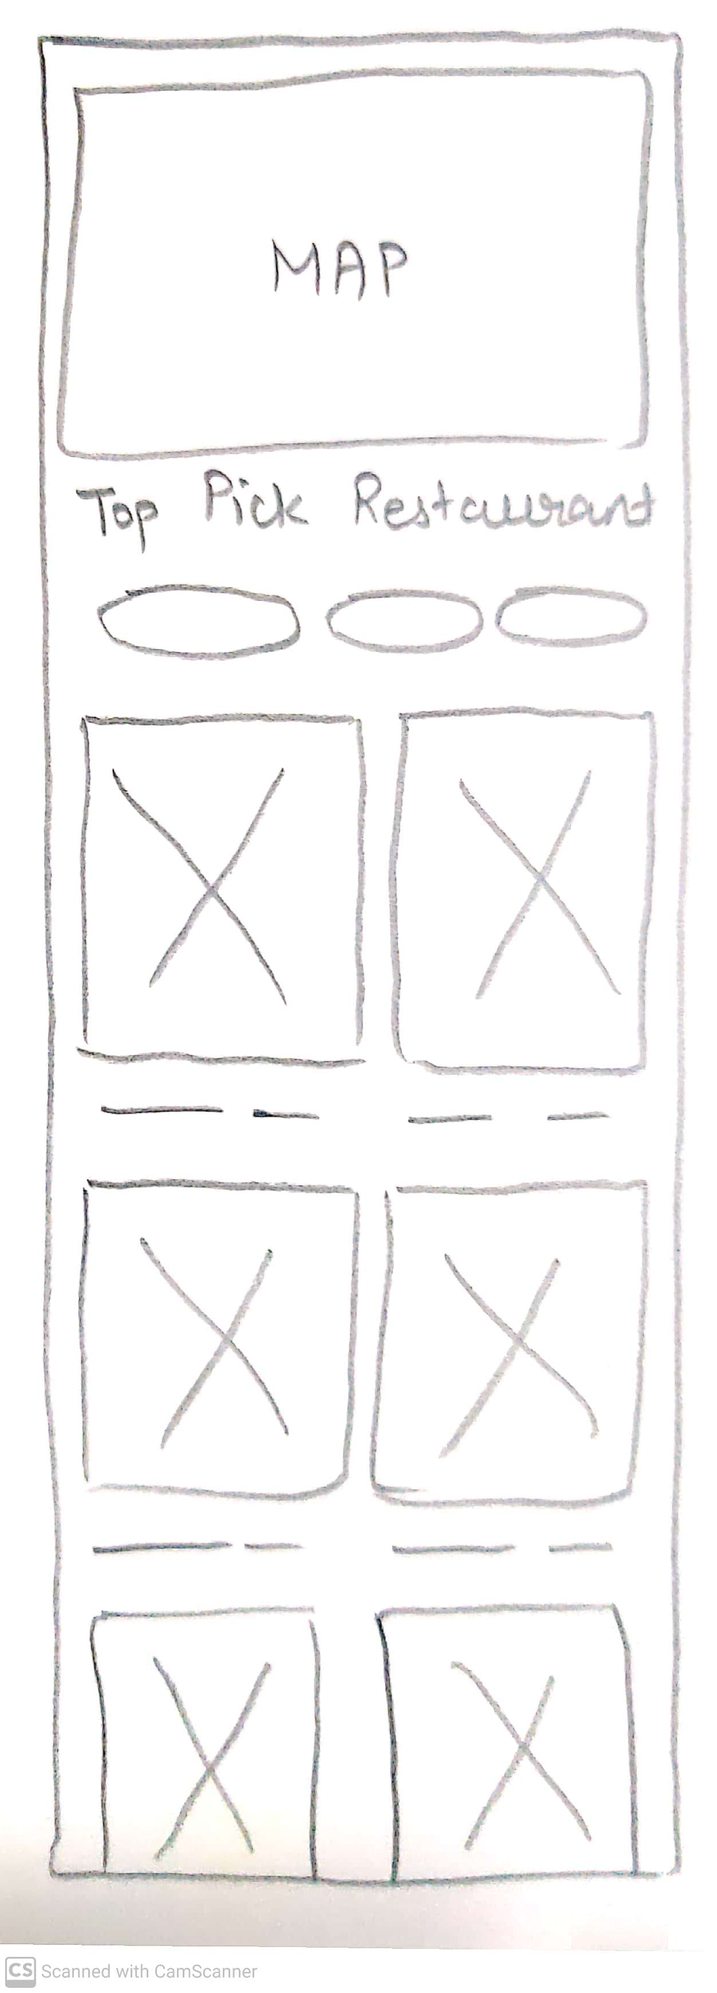
Browse Restaurant/Food Page
All this pages consist of a feature to browse restaurants in your city including a map showcasing above with their location of them. So you can select your favorite food from your top restaurants.
Notes:
© Copyright UpGrad Education Pvt. Ltd. All rights reserved

Slide 58
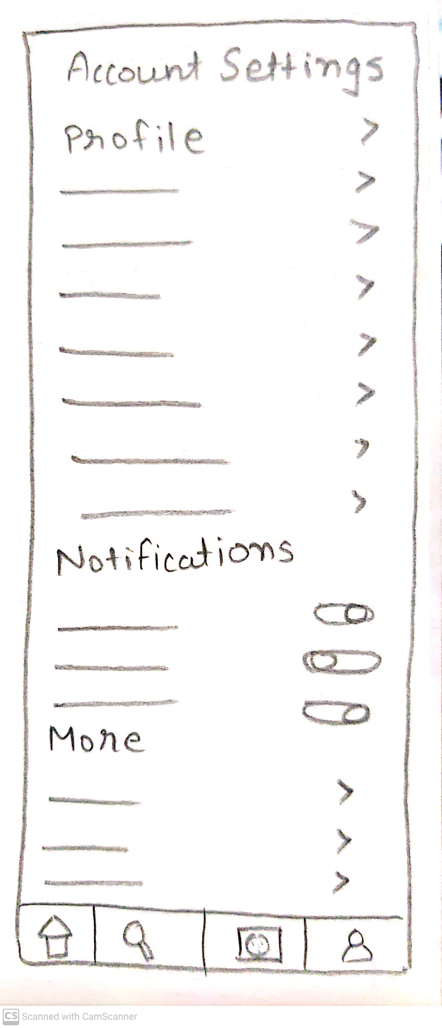
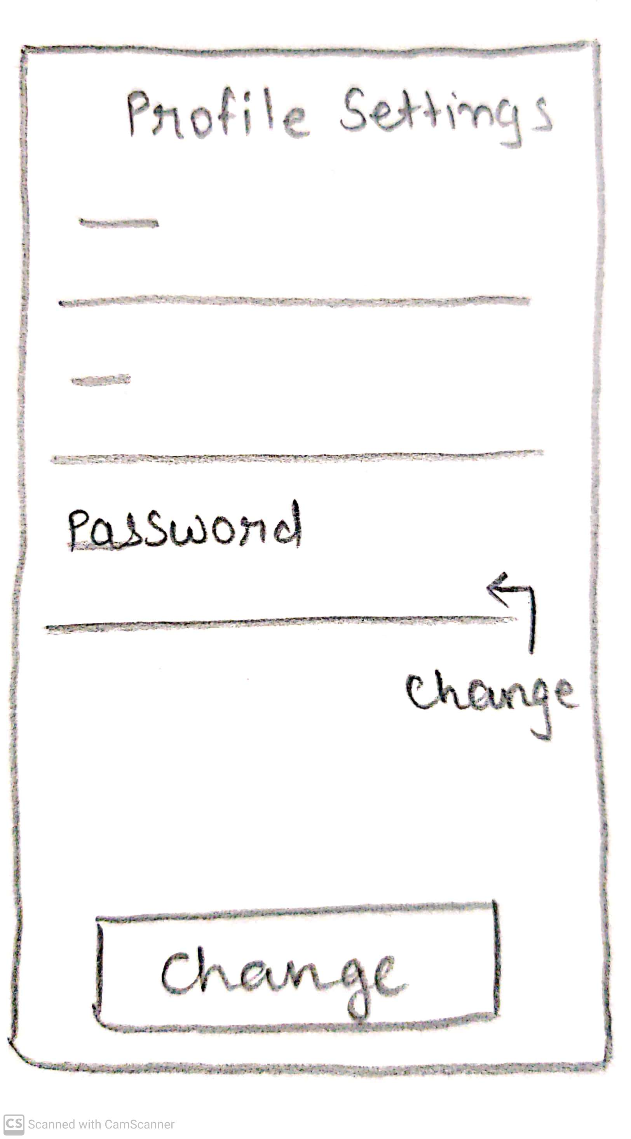
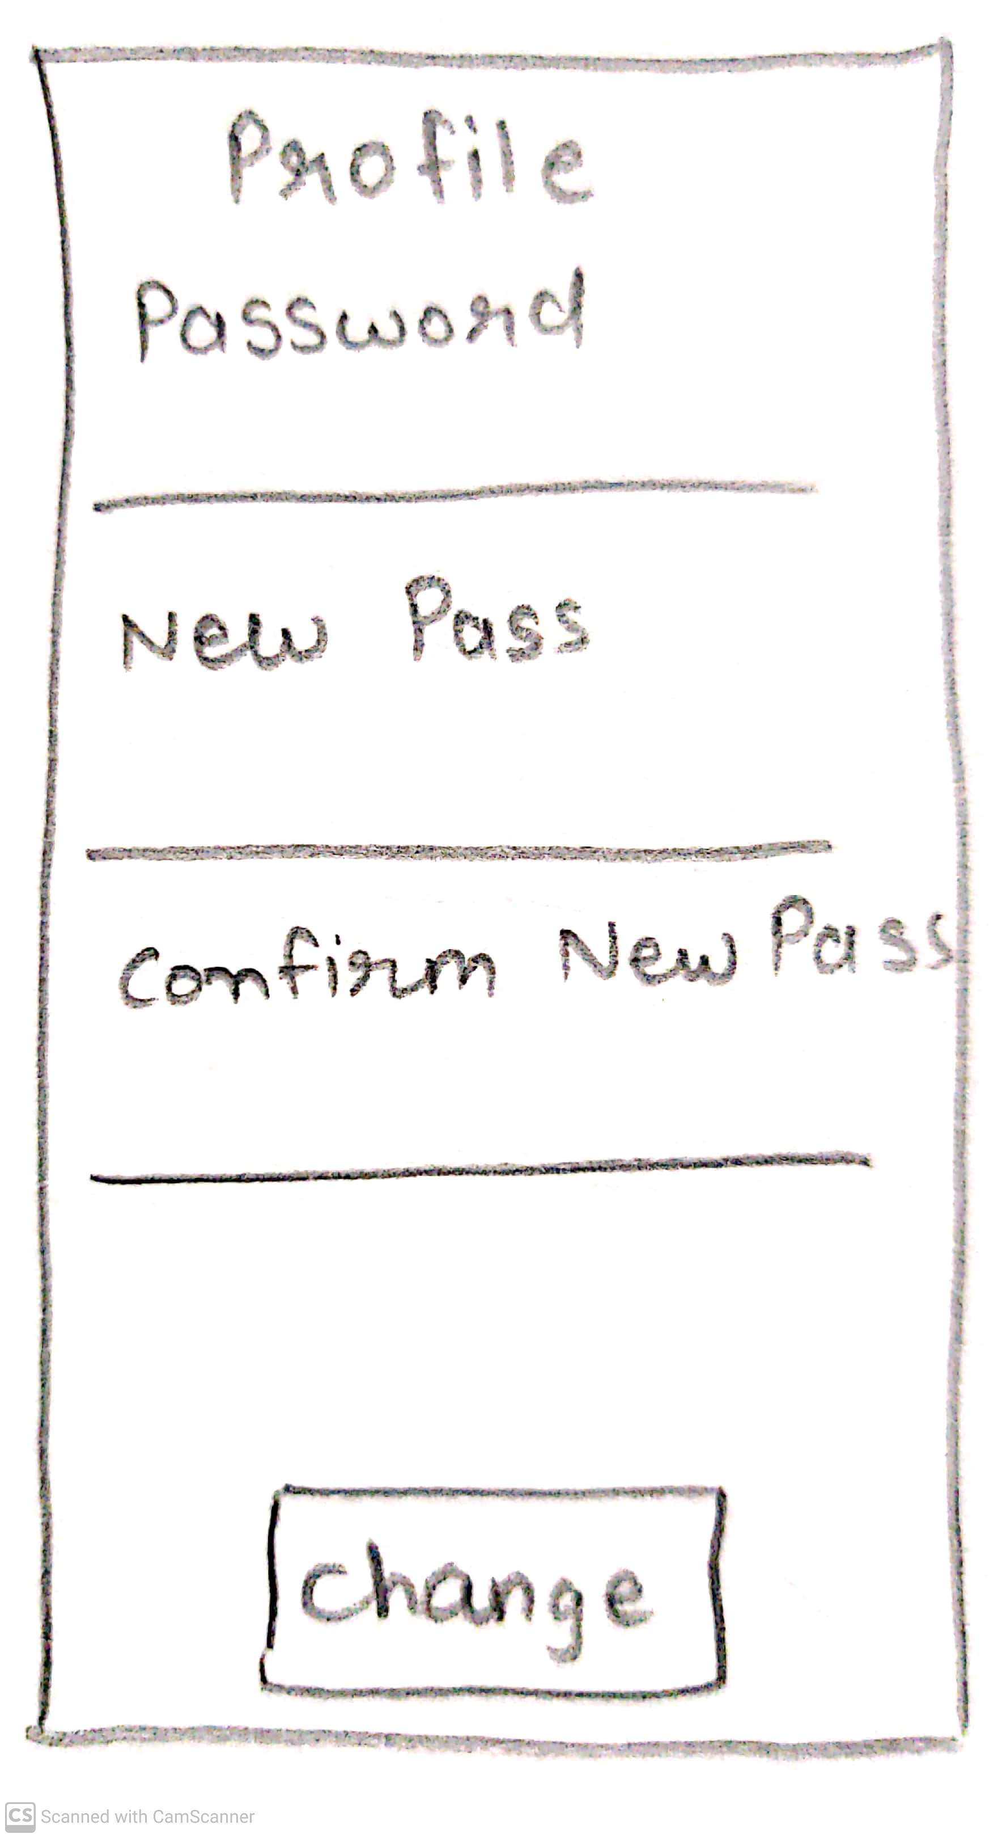
Account/Profile Settings Page
Account setting list of options and information over changing the setting of the app or personal information.
Profile Setting checking personal account information such as name, email, phone no, and password.
change password = the feature is added to change password in case forgotten.
Notes:
© Copyright UpGrad Education Pvt. Ltd. All rights reserved

Slide 59
Part 7: Wireframing and Prototyping
Notes:
© Copyright UpGrad Education Pvt. Ltd. All rights reserved

Slide 60
Wireframing
Wireframing | https://www.figma.com/file/j6cwOTkgVby9uSyg6aZIn2/wireframe-straw-hat?node-id=0%3A1&t=65bzSTXuPsm53EMY-0
Notes:
© Copyright UpGrad Education Pvt. Ltd. All rights reserved

Slide 61
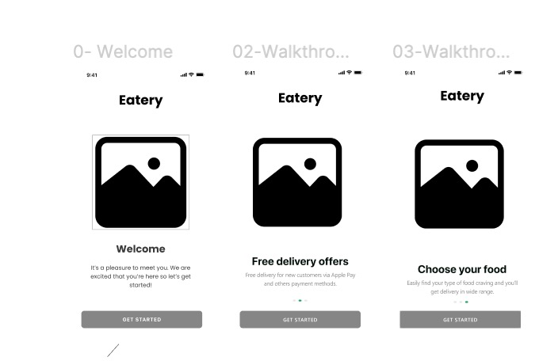
Welcome Page
Notes:
© Copyright UpGrad Education Pvt. Ltd. All rights reserved

Slide 62
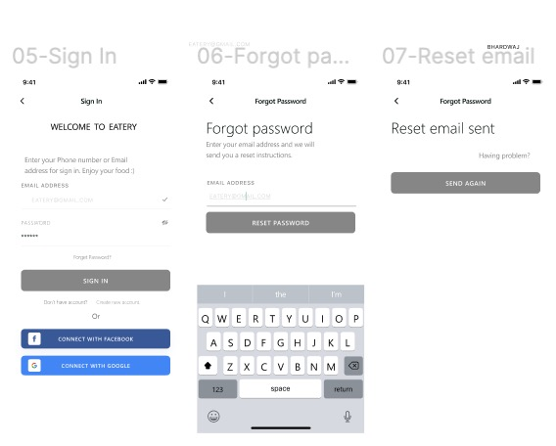
Sign In Pages
Notes:
© Copyright UpGrad Education Pvt. Ltd. All rights reserved

Slide 63
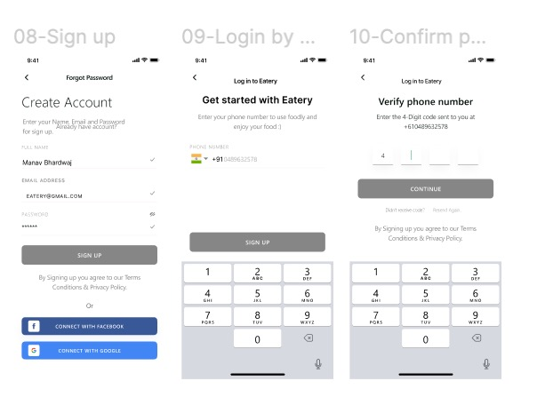
Sign Up/Login Pages
Notes:
© Copyright UpGrad Education Pvt. Ltd. All rights reserved

Slide 64
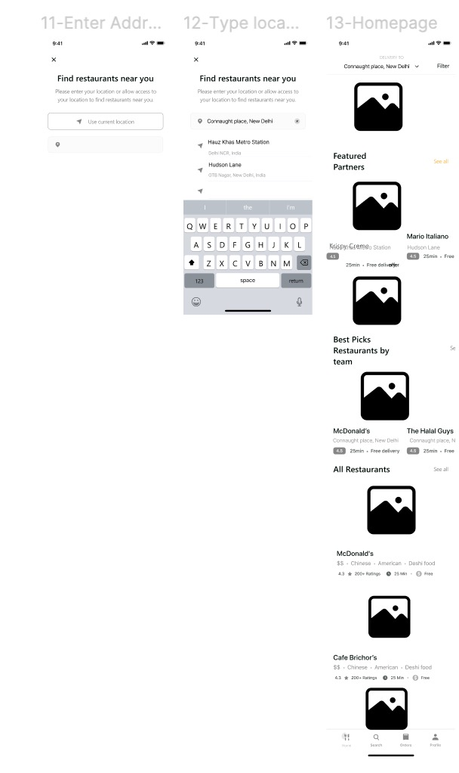
Address & Home Pages
Notes:
© Copyright UpGrad Education Pvt. Ltd. All rights reserved

Slide 65
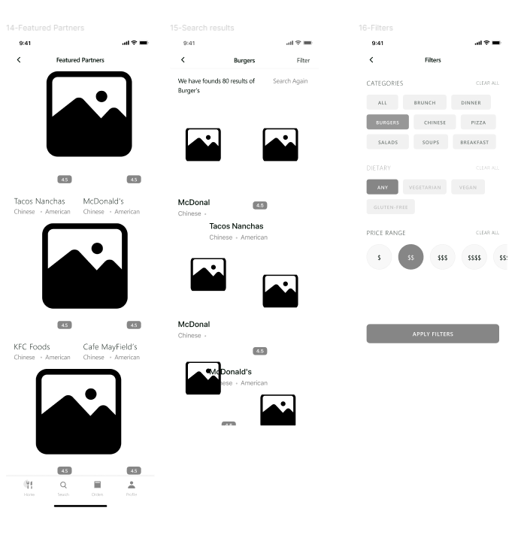
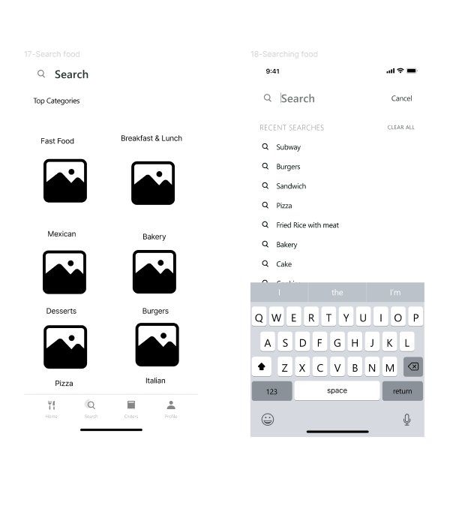
Featured/ Search / Filters Pages
Notes:
© Copyright UpGrad Education Pvt. Ltd. All rights reserved

Slide 66
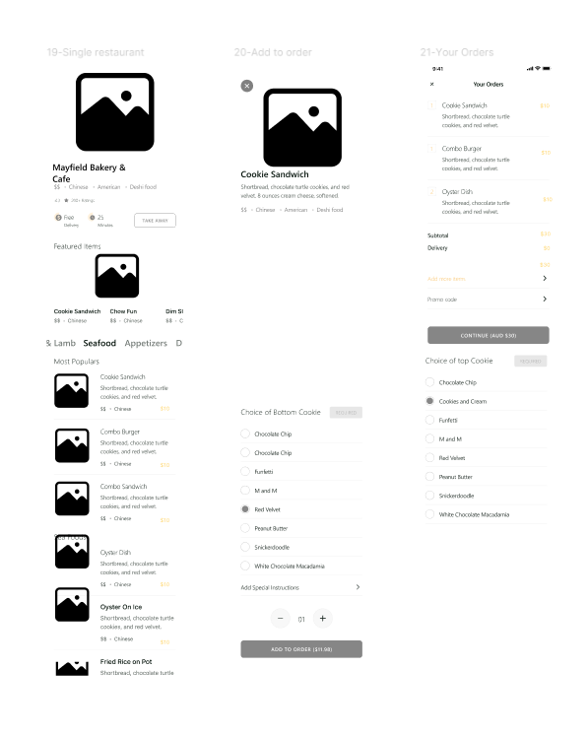
Single Restro/ Orders Pages
Notes:
© Copyright UpGrad Education Pvt. Ltd. All rights reserved

Slide 67
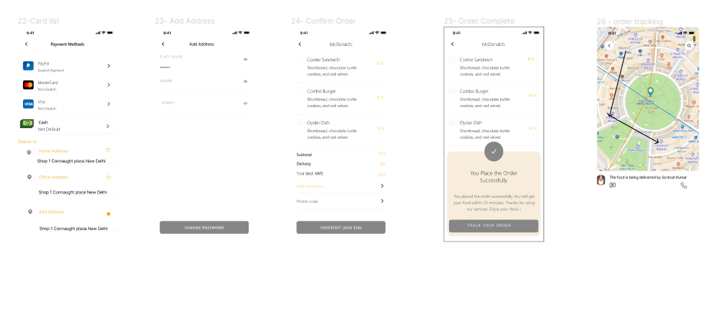
Payment/ Delivery/ Order Confirmation Page
Notes:
© Copyright UpGrad Education Pvt. Ltd. All rights reserved

Slide 68
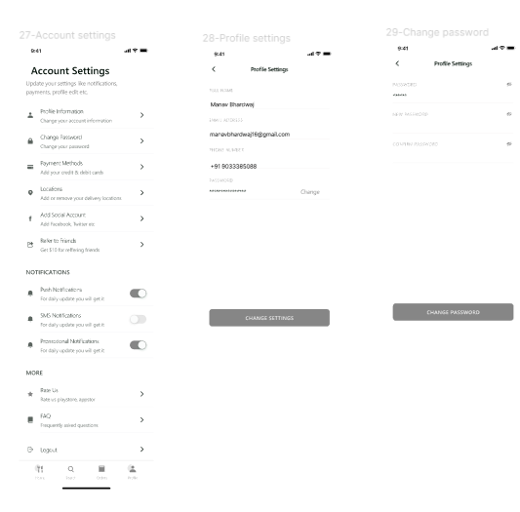
Account Settings Page
Notes:
© Copyright UpGrad Education Pvt. Ltd. All rights reserved

Slide 69

Referral/ Rating Page
Notes:
© Copyright UpGrad Education Pvt. Ltd. All rights reserved

Slide 70

Browse Page
Notes:
© Copyright UpGrad Education Pvt. Ltd. All rights reserved

Slide 71

Navigational Flow
Place the navigational flow structure here
Notes:
© Copyright UpGrad Education Pvt. Ltd. All rights reserved

Slide 72
Tools used
Wireframing | Figma
Prototyping | Figma
Notes:
© Copyright UpGrad Education Pvt. Ltd. All rights reserved

Slide 73
Prototyping
Prototyping | https://www.figma.com/file/aOY60Kvry67yCxVlDfPxCV/EATERY-FOOD-SERVICE-APP?node-id=13%3A955&t=HuARNbOJi4KHJ6dn-0
Notes:
© Copyright UpGrad Education Pvt. Ltd. All rights reserved

Slide 74
Disclaimer: All content and material on the UpGrad website is copyrighted material, either belonging to UpGrad or its bonafide contributors and is purely for the dissemination of education. You are permitted to access print and download extracts from this site purely for your own education only and on the following basis:
You can download this document from the website for self-use only.
Any copies of this document, in part or full, saved to disc or to any other storage medium may only be used for subsequent, self-viewing purposes or to print an individual extract or copy for non-commercial personal use only.
Any further dissemination, distribution, reproduction, copying of the content of the document herein or the uploading thereof on other websites or use of content for any other commercial/unauthorized purposes in any way which could infringe the intellectual property rights of UpGrad or its contributors, is strictly prohibited.
No graphics, images or photographs from any accompanying text in this document will be used separately for unauthorised purposes.
No material in this document will be modified, adapted or altered in any way.
No part of this document or UpGrad content may be reproduced or stored in any other web site or included in any public or private electronic retrieval system or service without UpGrad’s prior written permission.
Any rights not expressly granted in these terms are reserved.

